Slide 1

NEMOA Baseball
Baseball Umpire Training
PowerPoint created by John Hickey, 2012

Slide 2
Baseball Umpire MECHANICS

Slide 3
This presentation depicts the mechanics for hand signals that are used in various game situations. Knowledge of the mechanics does not preclude the pre-game discussion between the umpire crew.

Slide 4
ALWAYS TALK to YOUR PARTNER BEFORE TAKING THE FIELD !

Slide 5
PLATE MACHANICS
Basic Stances Behind The Plate

Slide 6
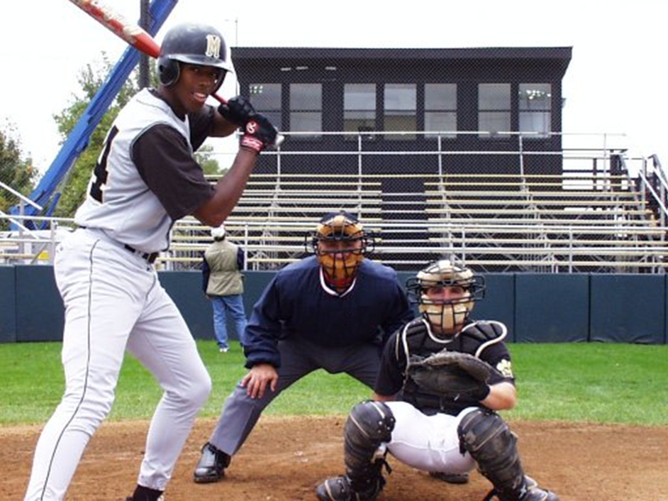
The BOX Stance
Notes:
The classic stance behind the plate. Positioned in the "slot" between the catcher and the hitter
Notice the head height. Make sure you can see the "money" pitch; the ball at the knees on the outside corner

Slide 7
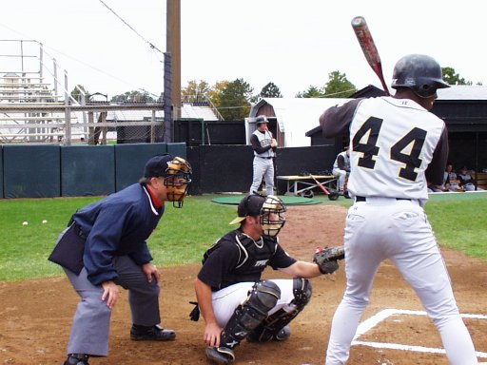
The BOX Stance side view

Slide 8
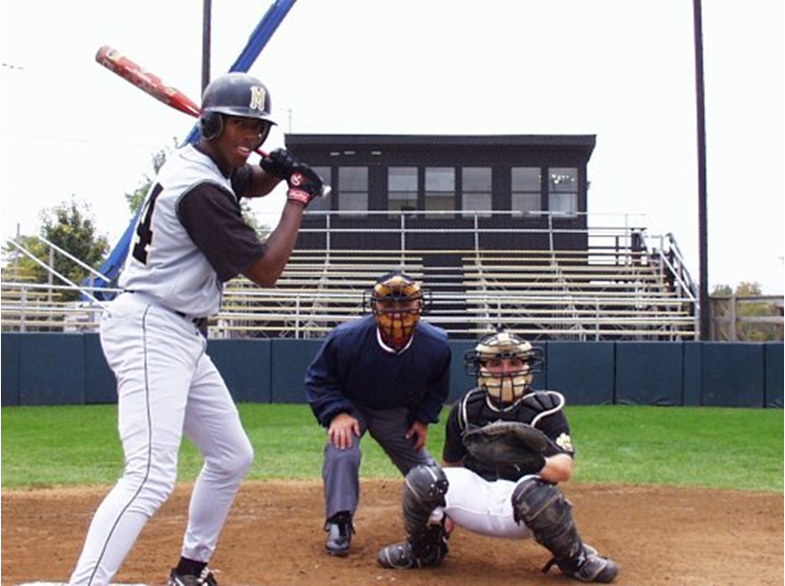
The SCISSORS Stance

Slide 9
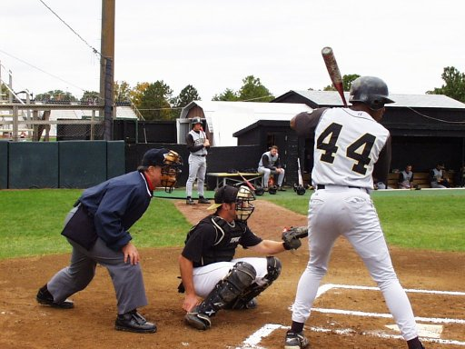
The SCISSORS Stance side view

Slide 10
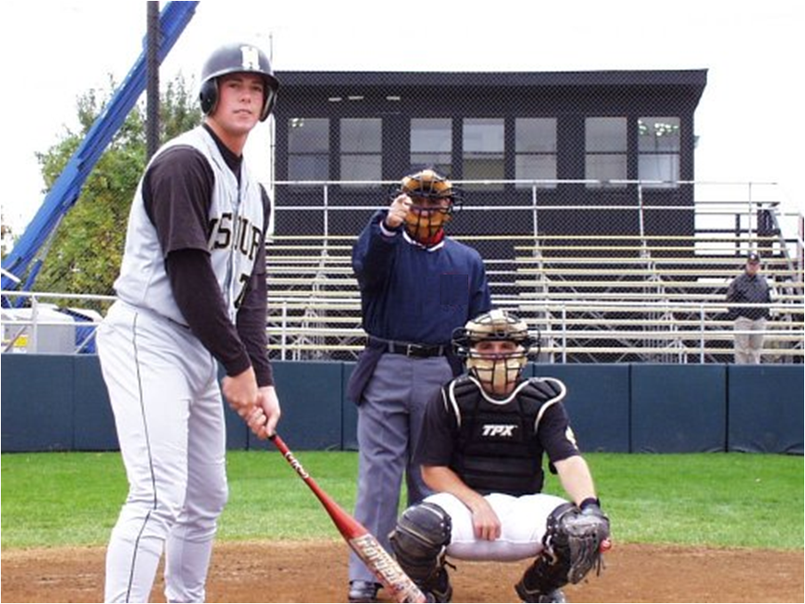
“PLAY !” Or “PLAY BALL!”

Slide 11
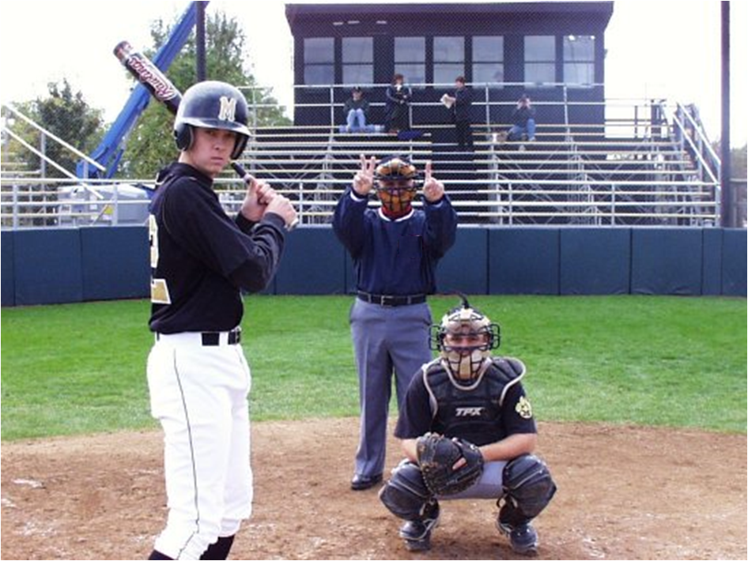
Showing the COUNT
When?
How often?
Notes:
Hands up high so the pitcher can see it; make sure you’re not blocked by the batter or a standing catcher.
You are NOT the scoreboard! Do not delay the game continuously giving the count because players are unaware of it...be reasonable...
Always indicate the count when putting a dead ball into play.
Speak loudly and clearly.
A common practice is to indicate the count once there are two strikes, three balls, or the count is full.
Always give the count if an at bat has been disrupted by play in the field.

Slide 12
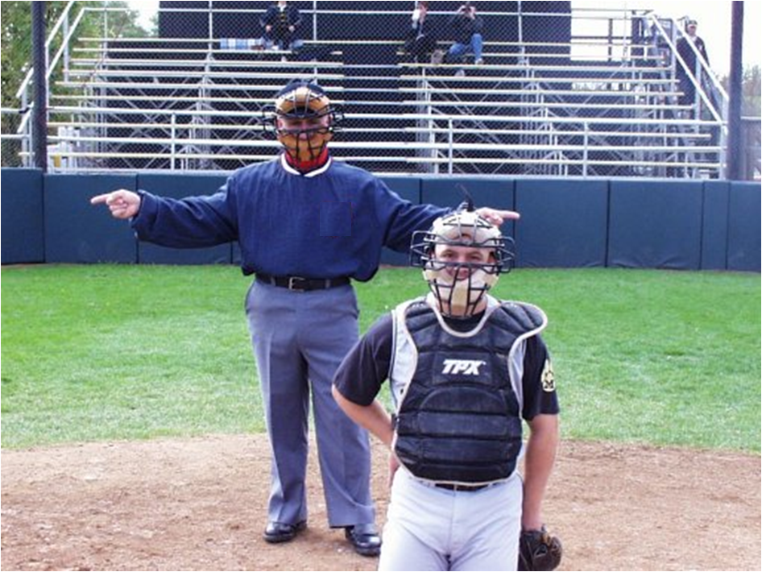
Signaling the number of OUTS

Slide 13
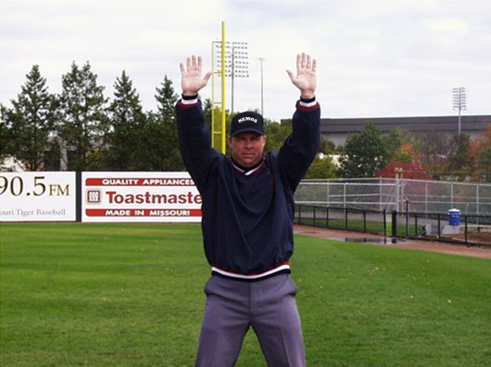
“Foul,”
“Time,”
“Dead Ball”

Slide 14
3 step sequence to making a “Safe” Call

Slide 15
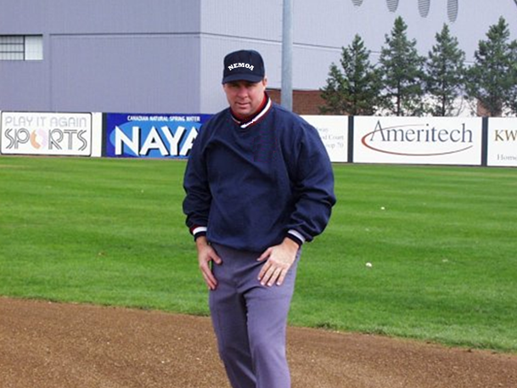
SEE the play.

Slide 16
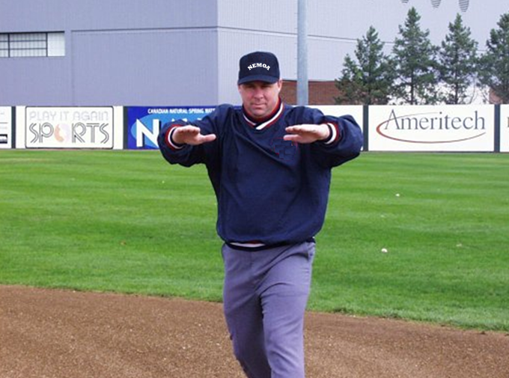
2) Start the call.

Slide 17
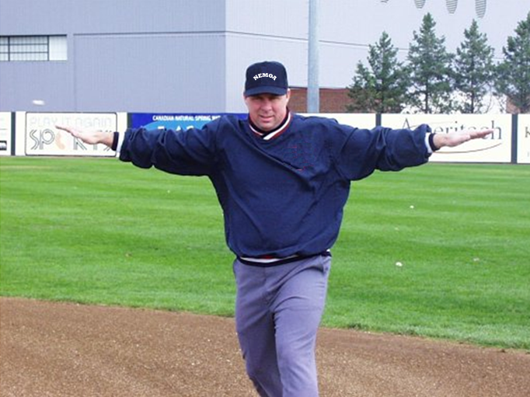
3) FINISH the call.

Slide 18
The following slide shows the step sequence for calling a runner safe followed by the proper mechanic for indicating the defender was “off the bag.”

Slide 20
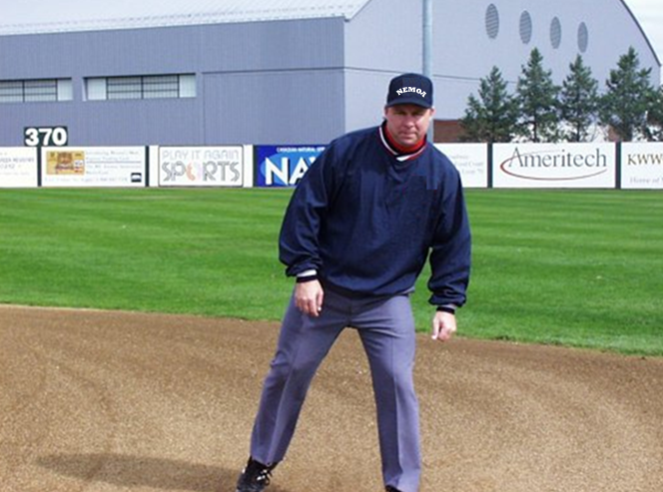

Slide 21
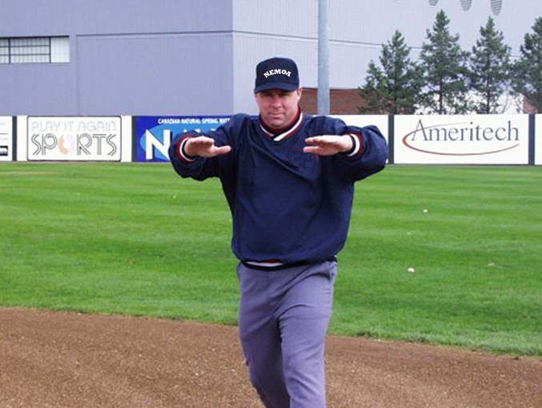

Slide 23
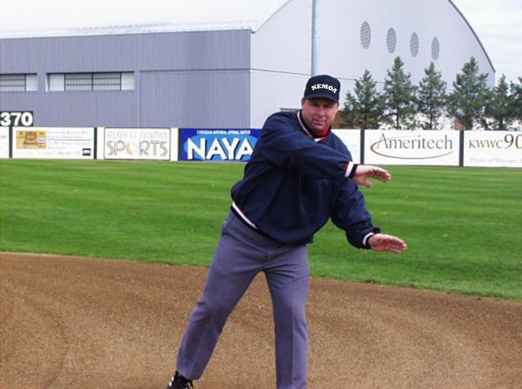

Slide 24
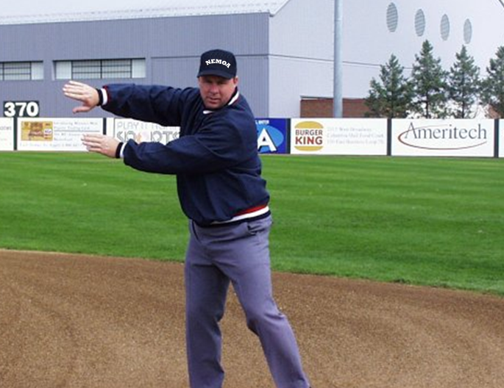

Slide 27
Again...

Slide 36
Calling a Runner “OUT”

Slide 37
Calling an “OUT”
A routine out should be called as indicated in the following slides...
A more “controversial”
i.e. “BANG-BANG” out
should be SOLD
using greater animation and a louder voice.

Slide 38
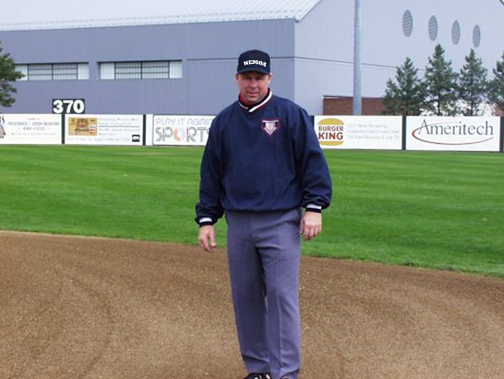

Slide 39
SEE the play.

Slide 40
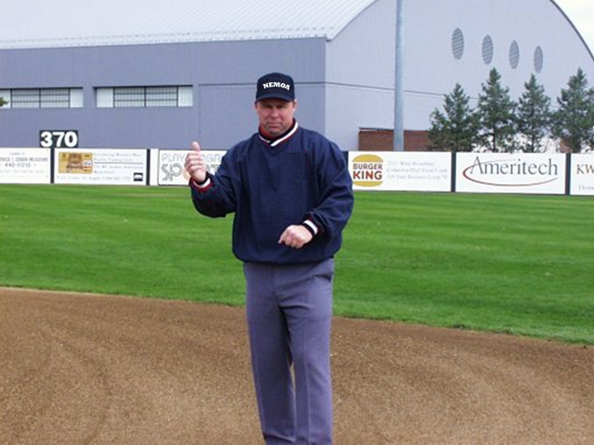
2) Start the call.

Slide 41
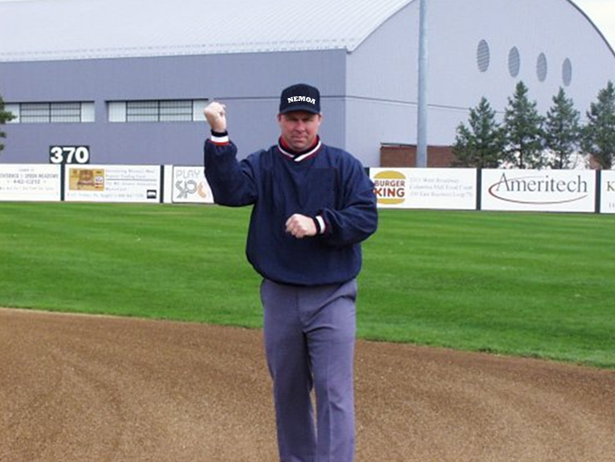
3) FINISH the call.

Slide 42
NEVER verbalize a “fair ball !”

Slide 43
“Foul
Ball !”
Loud and clear

Slide 44
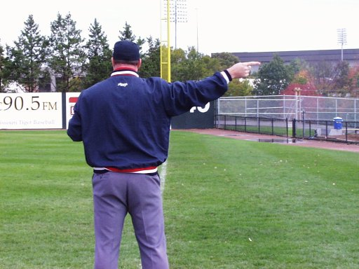
“FOUL BALL”
Down the line

Slide 45
The INFIELD FLY

Slide 46
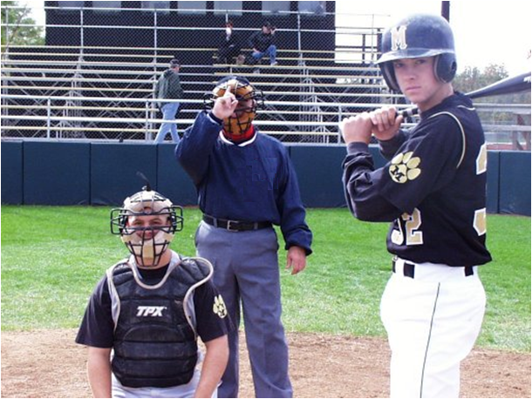
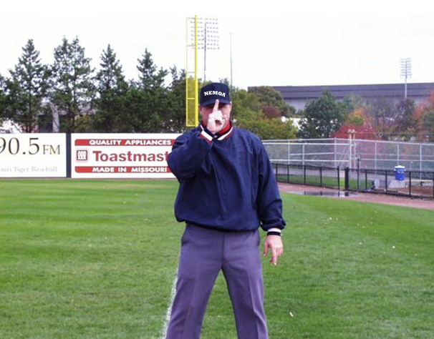
Runners on 1st and 2nd or 1st, 2nd and 3rd
with less than 2 out.
Touching the brim of your hat- fist indicates no outs, finger indicates one out.

Slide 47
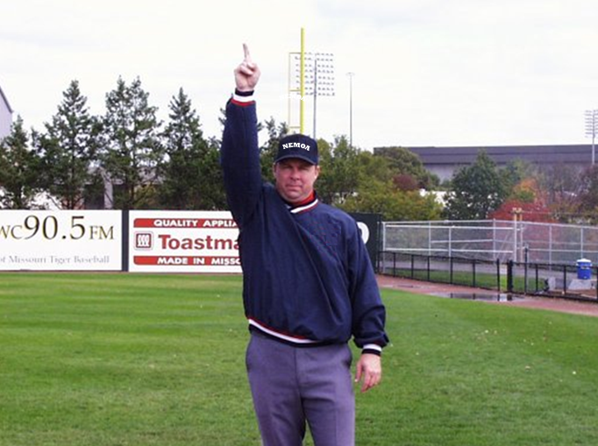
LOUD AND CLEAR!
“INFIELD FLY ! BATTER’S OUT !”
Usually called by the plate umpire
as both umpires signal,
but the base umpire cannot say,
“I thought he would call it,”
as a means of excuse...
When a ball is hit that you judge to be an infield fly,
both umpires use this signal after the ball has reached its apex.

Slide 48
The “TIMING PLAY”

Slide 49
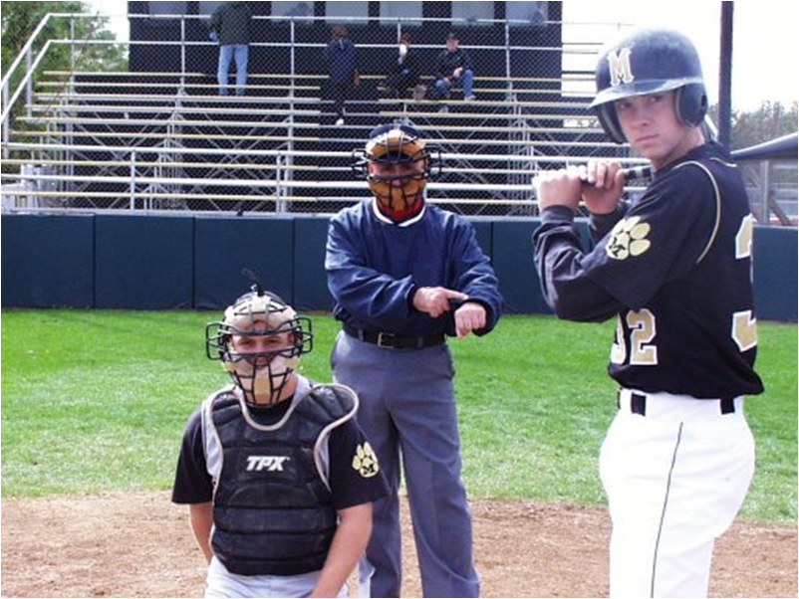
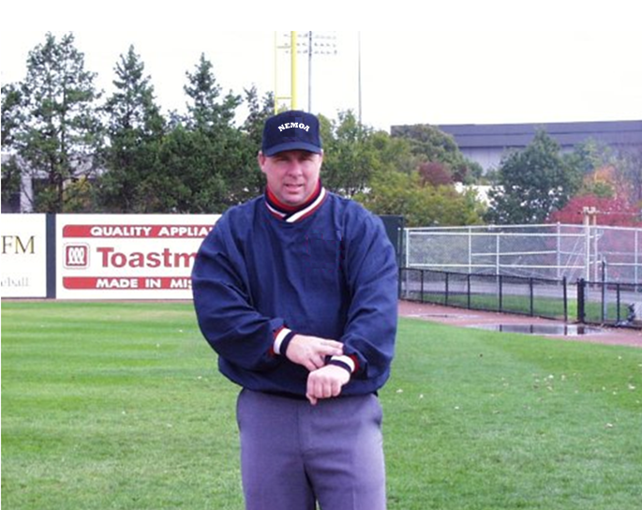
Runner on 2nd with 2 out. Watch the runner and the last out.
Did he score before the out; score the run. If not; waive it off...

Slide 50
Everyone needs to be in sync in this situation. The base umpire(s) must know that the timing of the 3rd out is critical to determine the time the runner crosses the plate.

Slide 51
Potential play-at-the-plate...

Slide 52
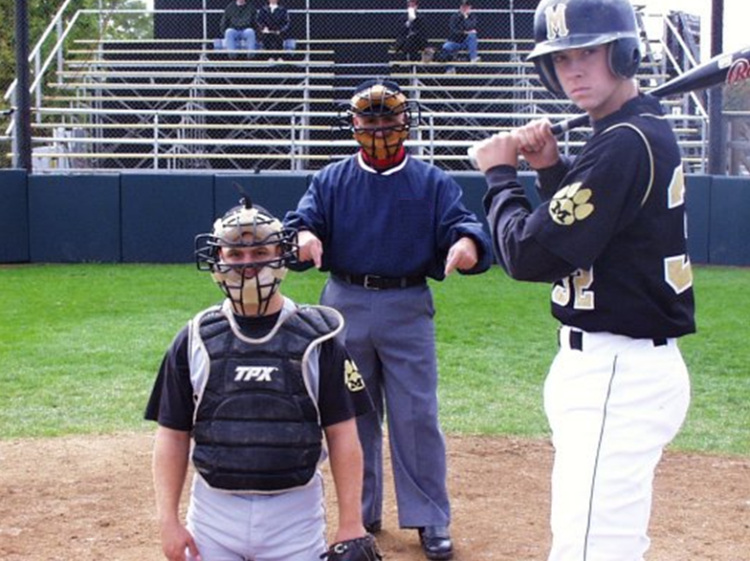
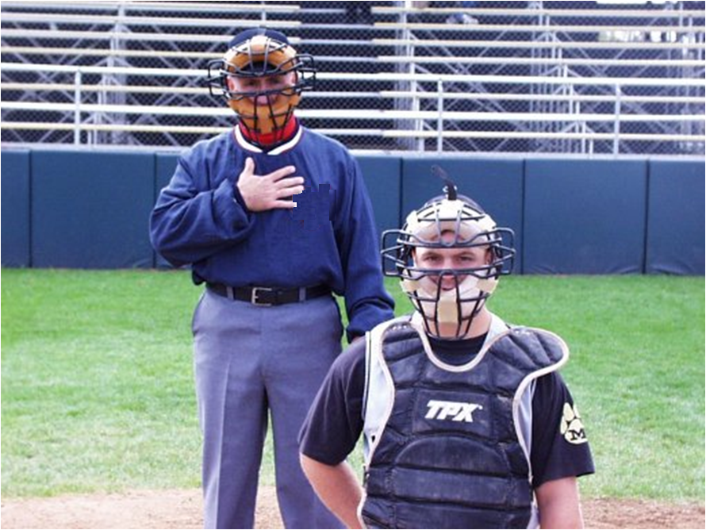
I’m staying home...
Depending on the situation,
there are situations which keep the plate umpire at home.

Slide 53
A Pending Appeal

Slide 54
When you know an appeal is about to be made,
communications with your partner(s) is essential to proper mechanics...
In this example the plate umpire knows he is responsible for the call and indicates to his partner(s) that he is making the call.

Slide 55
A CHECK SWING Appeal

Slide 56
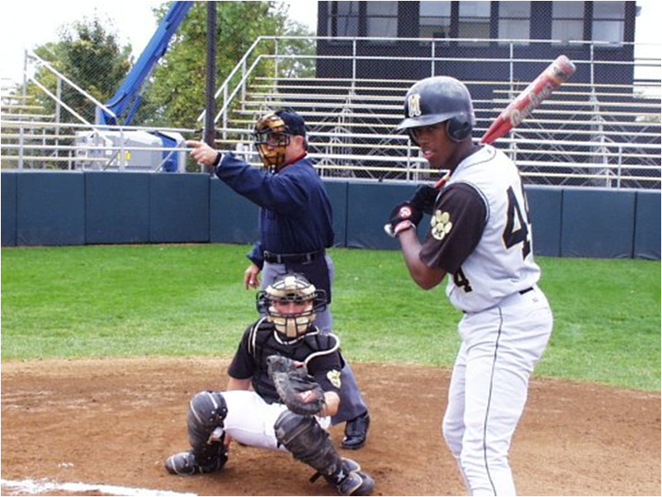
When you appeal a checked swing always use your left hand so the signal is not interpreted as a strike call.
“Did he go?”

Slide 57
What is the COUNT ?

Slide 58
Under construction... no photo available.
Tap the top of your head with your flat-handed open palm two times...
Don’t be obvious as that will just invite trouble!

Slide 59
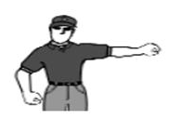
Delayed Dead Ball

Slide 60
Other mechanics
often used:

Slide 61
We need to talk...

Slide 62
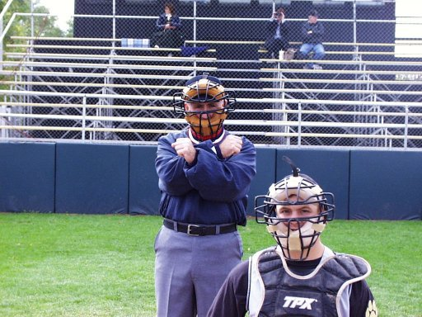
Avoid meeting often with your partner(s) but if you need to talk here's how to tell him...

Slide 63
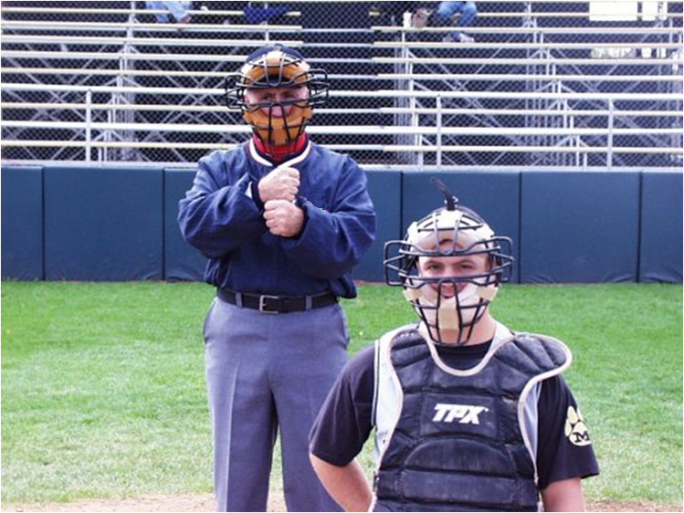
Even Umpires can make great plays...
Here’s an informal mechanic
for letting your partner know he’s made a great call !

Slide 64
Talk to your partner pre-game...
Most NEMOA Plate Umpires are very good about hustling to third and calling to the base umpire that they will make the call at third.
However, another mechanic that helps is a pre-play indication from the Plate Umpire to the Base Umpire that he will be covering a play at third base.
The following is the common mechanic for the plate umpire indicating that he is taking third base...

Slide 65
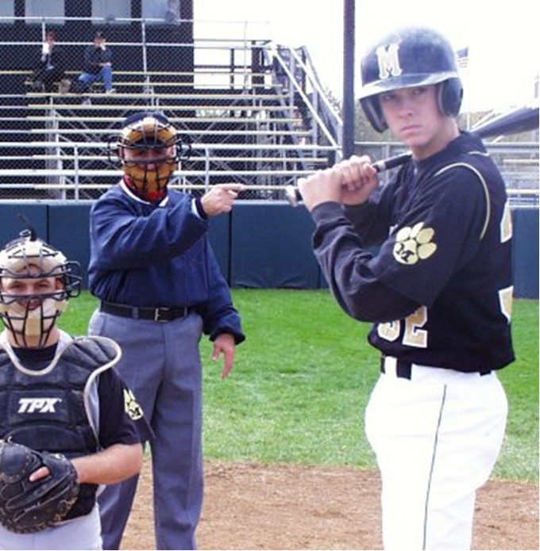
I’ve got the call at third base.

Slide 66
Never hesitate to ask either the NEMOA trainer or a fellow umpire... Asking questions is a sign of a willingness to grow and improve. Please feel free to ask questions whenever you have a concern.

Slide 67
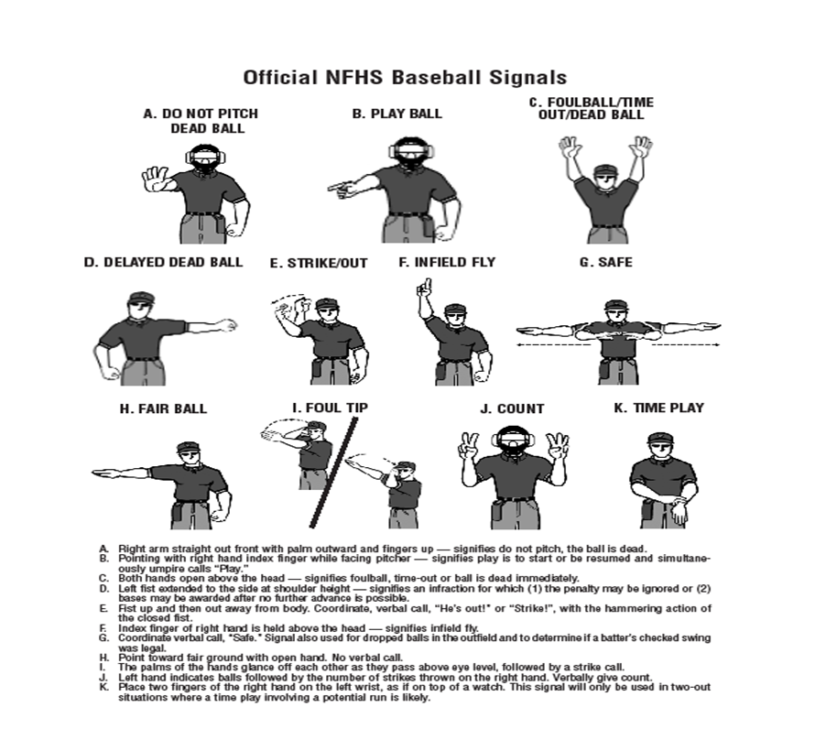

Slide 68
The bottom of this webpage links to a good animated baseball mechanics video clip:
http://epicsoftware.com/index.php/interactive_training/

Slide 69

Enjoy
the
Game !

