Slide 1

NEMOA Baseball
2013
Baseball Umpire Training
PowerPoint created by John Hickey, 2012

Slide 2

Baseball Training
Presentation
NFHS Rule 7
Batting

Slide 3
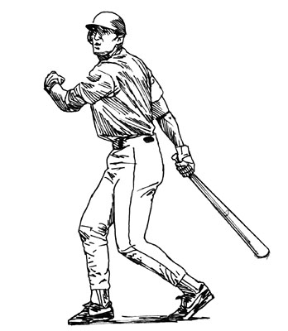
Batting
Position in the Batting Order
A batter is in proper order if he follows the player whose name precedes his in the lineup, even if the preceding batter batted out of order.
Note: The illegal batter is legalized when there is a pitch (legal or illegal), play or a balk.

Slide 4
Batting
Position in the Batting Order
If discovered during the at bat the illegal batter is replaced with the correct batter assuming the count...

Slide 5
Batting
Position in the Batting Order
If discovered after the at bat and before the next pitch the defense (only the defense) may appeal and the proper batter will be called out and the correct batter is the batter that follows in the line up.

Slide 6
Batting
Position in the Batting Order
Any outs on the play stand.

Slide 7
Batting
Position in the Batting Order
An out for
batting out of order
supersedes an out
made by the improper batter
on a play.

Slide 8
Batting
Position in the Batting Order
While the improper
batter is at bat,
any advances via stolen base,
balk, wild pitch or
passed ball are legal.

Slide 9

Batting
Position in the Batting Order
The improper batter
becomes a proper batter
because no appeal is properly made
the next legal batter shall be
the name that follows
the legalized batter in the lineup.

Slide 10
Batting
Position in the Batting Order
Note: When several batters
bat out of order
so that the player’s time at bat occurs while he is a base runner, such player remains on base (no out recorded) and the following batter in the lineup becomes the correct batter.

Slide 11
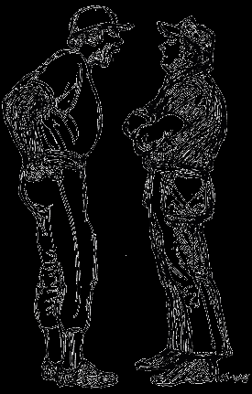

Excuse me,
Mr. Umpire, Sir, May I have a word with you?

Slide 12
Position in the Batting Order
Situation:
B7 bats instead of B5.
3-2 count when discovered
by anyone on either team.
Ruling:
The improper batter is replaced
with the proper batter
who assumes the count 3-2.

Slide 13
Position in the Batting Order
Situation:
B3 bats instead of B1,
B1 then follows B3 when he is discovered after his first pitch.
Who now is the correct batter?
Ruling:
The illegal batter is legalized when there is a pitch (legal or illegal), play or a balk.
B1 is legally at bat.

Slide 14
Position in the Batting Order
Situation:
R1 on 3rd, 2 outs.
Improper B5 @ bat, count = 1-1
During F1’s windup, R1 steals home
and beats the pitch.
The defense advises the umpire the proper batter is B4.
Ruling: B4 replaces the improper batter with the accumulated count.
The activity by the improper batter did not assist or advance R1 so the run scores.

Slide 15
7.2.1 Balls, Strikes, Hits
A “STRIKE” is charged to the batter when:
A pitch enters any part of the strike zone in flight and is not struck at.
A pitch is swung at and missed.
A pitch is fouled off and there are less than 2 strikes.

Slide 16
7.1.2 Balls, Strikes, Hits
A “STRIKE” is charged to the batter when:
A pitch is a foul tip after 2 strikes.
A pitch fouled from an attempted bunt.

Slide 17
7.1.2 Balls, Strikes, Hits
A “STRIKE” is charged to the batter when:
A batted ball contacts the batter in the batters box.
A batter delays, (batter steps out with both feet), “strike”, second strike if pitch is made!

Slide 18
7.2.2 Balls, Strikes, Hits
A “BALL” is credited
when a pitch isn’t touched by the bat
and is not in the zone
or is an illegal pitch.

Slide 19
Excuse me,
Mr. Umpire, Sir, May I have a word with you?

Slide 20
Ruling:
Situation:
Having trouble
throwing strikes,
the batter assumes an exaggerated crouch to shrink the strike zone.
On a chin high pitch the umpire calls a “strike,” now the offense coach asks how this is determined.
The pitch is called
using judgment
of the
natural batting stance.

Slide 21
Ruling:
Situation:
B1 starts a swing or a bunt but holds back; how do we determine what to call the pitch?
The rule that
should be followed
is that if the bat is swung so it is in front of or ahead of the body it should be called a strike.
Bat in relation to the plate is poor reference.

Slide 22

BATTING INFRACTIONS

Slide 23

7.3.1
Batting
Infractions
Delay of game
if batter fails to take
his batting
position
within
20 seconds.

Slide 24
7.1.3
Batting
Infractions
The batter
must keep one foot
in the box
throughout
the time
at bat.

Slide 25
7.3.1 Batting Infractions Exceptions:
A batter may leave the batter’s box
when...
a. The batter swings at a pitch.

Slide 26
7.3.1 Batting Infractions Exceptions:
A batter may leave the batter’s box
when...
b. The batter is forced out of the box by the pitch.

Slide 27
7.3.1 Batting Infractions Exceptions:
A batter may leave the batter’s box
when...
c. The batter
attempts a
“drag bunt”.
Be aware of foot position
when ball contacts the bat.

Slide 28
7.3.1 Batting Infractions Exceptions:
A batter may leave the batter’s box
when...
d. The Pitcher
or catcher
attempt a play
or feint a play.

Slide 29
7.3.1 Batting Infractions Exceptions:
A batter may leave the batter’s box
when...
e. The pitcher
takes a position 5 feet
or more away from
the pitching plate.

Slide 30
7.3.1 Batting Infractions Exceptions:
A batter may leave the batter’s box
when...
f. Time is called
by anyone
on either team.

Slide 31
7.3.1 Batting Infractions Exceptions:
A batter may leave the batter’s box
when...
g. The catcher
leaves catcher’s box
to adjust equipment or to give defensive signals.

Slide 32
7.3.1 Batting Infractions Exceptions:
A batter may leave the batter’s box
when...
h. The Catcher
doesn’t catch the
pitch.

Slide 33
Excuse me,
Mr. Umpire, Sir, May I have a word with you?

Slide 34
7.3.1 Batting Infractions
Situation:
B1 leading off decides to try to upset F1
and delays entering the batter’s box.
F1 seeing B1 not in the box doesn’t assume the pitching position.
20 seconds elapse.
Ruling:
Strike on the batter.
While F1 didn’t deliver the pitch within 20 seconds, he cannot pitch until the Batter enters the box.

Slide 35
7.3.1 Batting Infractions
Situation:
B1 in the box, F1 on the rubber.
After 10 seconds F1 steps back off the rubber to speak to F6 and then 20 seconds elapse.
Ruling:
Since F1 is responsible for the delay
B1 should be awarded a “ball.”
Note:
If F1 steps off or B1 steps out for a good reasons such as to tie his shoe, wipe off sweat, or for other obvious reasons the umpire should grant time.

Slide 36
7.3.1 Batting Infractions
Situation:
B1 with 3-1 count, on the next pitch the batter assumes ball 4 and heads for 1st, while the umpire calls strike 2.
Disgusted B1 takes his time returning to the batters box (< 20 seconds).
Ruling:
The Umpire should call strike 3 for delay of game.
...and prepare for some “discussion.”

Slide 37
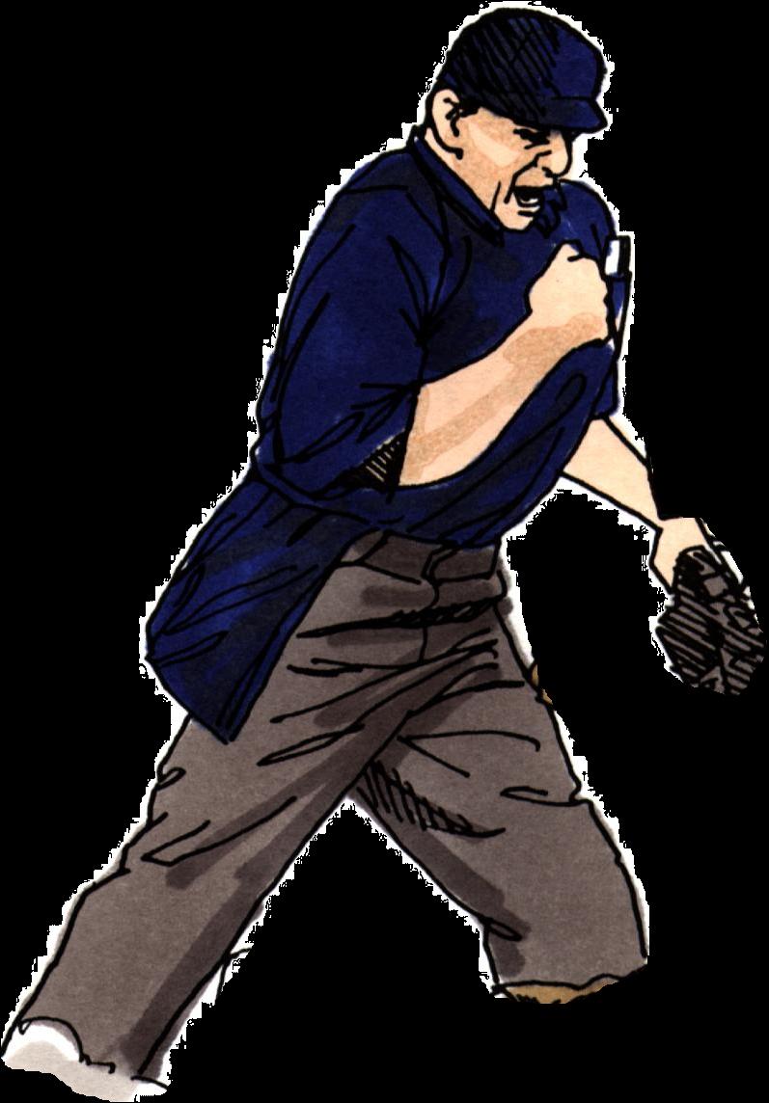
7. 2 & 3
The ball is immediately dead
and the batter is OUT...
...if the batter
hits the ball either fair or foul
while either foot or knee is
in contact with the ground
outside the batters box
or touching the plate.

Slide 38
7. 2 & 3
The ball is immediately dead
and the batter is OUT...
...if the hitter
is disconcerting the pitcher by stepping from the box on one
side of home plate to the
box on the other side
while the pitcher is in
position ready to pitch.

Slide 39
Excuse me,
Mr. Umpire, Sir, May I have a word with you?

Slide 40
Ruling:
Situation:
The batter is considered to be in the batter’s box when no part of either foot is touching the ground entirely outside the lines forming the batters box since the lines are part of the box.
When is the batter’s foot considered inside the batter’s box?
Note: The batter may contact the ball with one foot
in the box and the other in the air outside the box.

Slide 41

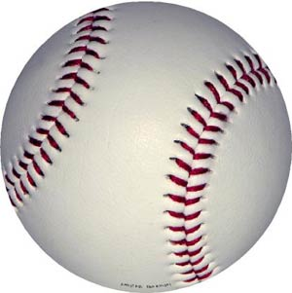
Ruling:
“Dead Ball!”
The pitch is called a “ball or strike” and the batter remains at bat unless it’s strike 3 or ball 4.
Art.4
The Batter permits a pitched ball to touch him...

Slide 42
Art 4 Batter permits a ball to touch him:
Situation
R1 on 1st,
count 0-2 on B3,
R1 stealing on the pitch
which hits batter during swing and miss.
Ruling:
“Dead Ball!”
Strike 3, batter’s out!
R1 is returned to 1st.

Slide 43
Art 4 Batter permits a ball to touch him:
Situation
3-2 count on B1,
the next pitch hits B1’s fist
without contacting the bat
and goes into foul territory.
Ruling:
“Dead Ball,” the batter’s out!
If the ball contacts any part of the body during a swing,
the ball’s dead and a strike is called.
It’s a “Foul ball,” if the pitch hits the bat first and then the batter’s body while he is in the box.

Slide 44
Art 4 Batter permits a ball to touch him:
Situation
3-1 count on B1,
B1 has elbow hanging in the zone,
the pitch hits him on the shoulder.
Ruling:
“Dead Ball!”
“Ball 4,” batter takes his base.

Slide 45
Art 4 Batter permits a ball to touch him:
Situation
3-1 count on B1,
B1 has elbow hanging in the zone,
the pitch hits the batter in the elbow.
Ruling:
“Dead Ball!”
Strike 2.

Slide 46
Art 4 Batter permits a ball to touch him:
Situation
3-0 count on the batter,
the batter is fooled by the pitch and makes no attempt to avoid getting hit.
Ruling:
“Dead Ball!”
The batter is awarded 1st base.

Slide 47
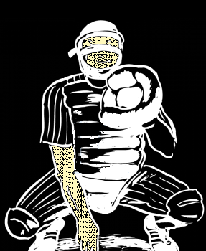
Art 5 Interfere with catcher’s fielding or throwing by:
a) Leaning over the plate,
b) stepping out of the batter’s box,

Slide 48
Art 5 Interfere with catcher’s fielding or throwing by:
c) making any other movement which hinders actions at home
plate or the catcher’s
attempt to make a play
on a runner,

Slide 49
Art 5 Interfere with catcher’s fielding or throwing by:
d) Failing to make a reasonable effort to vacate a congested area when
there is a throw to home
plate and the there is
time for the batter to
move away.

Slide 50
The PENALTY for any of these interferences:
When there are 2 outs, the batter is out.

Slide 51
The PENALTY for any of these interferences:
When there are less than 2 outs and the
runner is advancing
home and is tagged
out the interference
is ignored and the
ball remains live.

Slide 52
The PENALTY for any of these interferences:
If the runner advancing home is not tagged out, the ball
becomes dead (delayed dead ball)
the runner is out and the
batter remains at bat;
the ball remains live.

Slide 53
The PENALTY for any of these interferences:
When an attempt to make
a play at any other base
is unsuccessful,
the batter is out and
all runners return to
the base occupied
at the T.O.P.

Slide 54
The PENALTY for any of these interferences:
If the pitch is a third strike and
in the umpire’s judgment
the interference prevents
a double play,
the second out
may be called.

Slide 55
Excuse me,
Mr. Umpire, Sir, May I have a word with you?

Slide 56
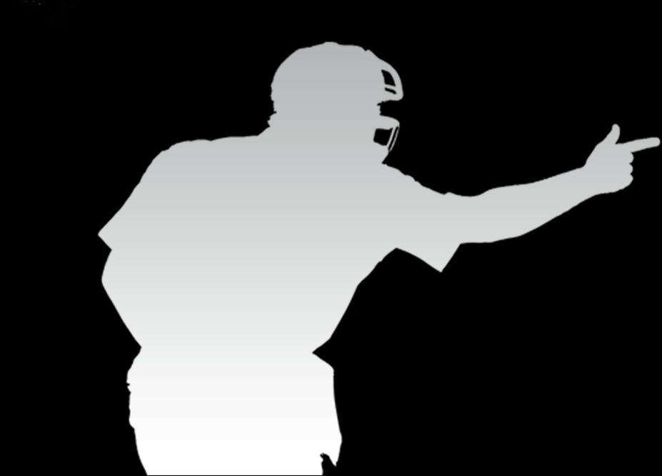
Interference with the CATCHER...
Situation:
R1 on 1st, 1 out,
B4 swings and misses for strike 2
and interferes with F2’s throw to 2nd in an effort to put out advancing R1.
Ruling;
“Dead Ball”,
B4 is out and
R1 returns to 1st

Slide 57
Interference with the CATCHER...
Situation:
R1 stealing 3rd on the pitch, B2 steps across home plate to hinder F2
who is fielding
or throwing
or attempting to throw
to 3rd,
Ruling;
If R1 is thrown out with less than 2 outs
the ball remains live.

Slide 58
Interference with the CATCHER...
Situation:
R1 stealing 3rd on the pitch, B2 steps across home plate to hinder F2
who is fielding
or throwing
or attempting to throw
to 3rd,
Ruling:
If R1 isn’t tagged out, B2 is out and ball becomes dead with less than 2 outs and runners return to the base at T.O.P.

Slide 59
Interference with the CATCHER...
Situation:
1 out, R1 on 1st, 0-2 on B3, R1 stealing on the pitch,
B3 swings and misses
“strike 3”, and also interferes with F2 attempting play on R1.
Ruling:
Umpire judgment: if F2 could have thrown out R1 you would have out # 3, otherwise R1 returns to base at the T.O.P

Slide 60
Interference with the CATCHER...
Situation:
1 out, R1 on 2nd, right-handed B2 at bat, R1 attempts to steal 3rd while B2 (swinging or not) makes no
attempt to get out of the way
or is unable to
get out of the way
of F2 throwing making
a play to 3rd.
Ruling:
B2 is entitled to his position in the batters box and isn’t guilty of interference in either situation.

Slide 61
Interference with the CATCHER...
Situation:
1 out, R1 on 2nd, right-handed B2 at bat, R1 attempts to steal 3rd while B2 (swinging or not) makes no
attempt to get out of the way
or is unable to
get out of the way
of F2 throwing making
a play to 3rd.
Ruling:
Unless he moves
or re-establishes his
position after F2 has
received the pitch,
which then prevents
F2 from making a play.

Slide 62
Interference with the CATCHER...
Situation:
1 out, R1 on 2nd, right-handed B2 at bat, R1 attempts to steal 3rd while B2 (swinging or not) makes no
attempt to get out of the way
or is unable to
get out of the way
of F2 throwing making
a play to 3rd.
Ruling:
Failing to move so F2 can make the play isn’t interference in itself.

Slide 63
Interference with the CATCHER...
Situation:
No Outs, R1 on 3rd, F1 in the set legally step backwards off the rubber and throw home to make play
on R1 stealing home.
B2 hits the ball.
Ruling:
Typically, batter’s
interference is a delayed
dead ball in order to give the defense
an opportunity to make an out on the initial
putout attempt. Since the batter hit the ball the
defense wasn’t afforded the opportunity to make a
play. Therefore, the ball is declared dead
immediately, R1 is out because of B2’s interference.

Slide 64



