Slide 1

NEMOA Baseball
Baseball Umpire Training
PowerPoint created by John Hickey, 2012

Slide 2
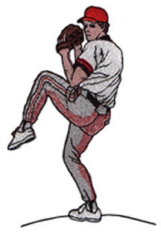
Baseball Training Presentation
NFHS Rule 6
Pitching

Slide 3

6-1-1
Pitching
The pitcher shall face the batter from either the windup or set position, determined by the positioning of his feet.
The pitcher shall take his sign from the catcher with his pivot foot in contact with the pitching plate.

Slide 4
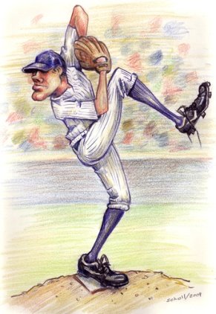
6-1-1
Pitching
The pitching regulations begin when the pitcher intentionally contacts the pitchers plate.
Turning the shoulders after bringing the hands together during or after the stretch is a balk.

Slide 5
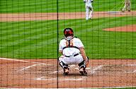
6-1-1
Pitching
The pitcher shall not make a quick-return pitch in an attempt to catch the batter off balance.
The catcher shall have both feet within the catchers box (8', 43") at T.O.P.

Slide 6


6-1-1
Pitching
An ambidextrous pitcher is required to face the batter as either a left or right handed batter, not both. He may change with each new batter.

Slide 7
6-1-1
Pitching
Situation:
While in the wind-up or set position, the
pitcher can adjust his hat, shake off a signal
with either his glove or head.
Ruling:
Ruling:
Okay and legal as long as the motion isn't associated with a pitching motion.

Slide 8
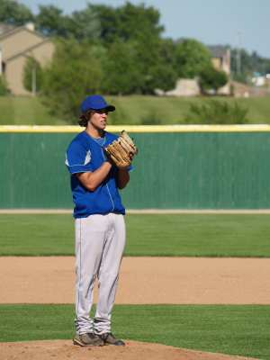
6-1-2
Pitching in the WIND-UP
With his feet in the wind up position
the pitcher can only:
1) deliver a pitch
2) step backward off the pitcher's plate with his pivot foot.

Slide 9
6-1-2
Pitching in the WIND-UP
The pitcher is not restricted
as to how he holds his hands.
Together in front of his body
Both hands down at his side
Either hand in front and the other at his side.

Slide 10
6-1-1
Pitching
Situation:
Runner on 3rd, Pitcher steps on the rubber,
glove hand in front pitching hand down at side,
Gets the sign then brings hands together and stops
Legal.
Immediately brings hands together to take sign
Legal.
Gets the sign then begins delivery
Legal.

Slide 11

Situation:
> R1 on 3rd, Pitcher steps on rubber with hands together in front of body, then drops pitching hand to side and stops.
Ruling:
Ruling: This is a Balk.

Slide 12
Situation:
> F1 steps with both hands together, moves his non-pivot foot behind the rubber then stops
Ruling:
Ruling: "Balk" with runners,
illegal pitch without.

Slide 13
Situation:
> With one hand at his side and one in front of his body the pitcher brings hands together, pauses,
Ruling:
Ruling: Legal

Slide 14
6-1-2
Pitching in the WIND-UP
The pitcher’s non-pivot foot can be in any position on or behind the line extending through the front edge of the pitching plate.

Slide 15
6-1-2
Pitching in the WIND-UP
The pitcher is limited
to 2 pumps or rotations,
once he starts his movement he must continue the motion without interrupting or alteration.

Slide 16
6-1-2
Pitching in the WIND-UP
During delivery, the pitcher may
lift his non-pivot foot in a:
1) step forward
2) step sideways
3) step backwards and forwards.

Slide 17
6-1-2
Pitching in the WIND-UP
After the pitcher has placed his pivot
foot clearly behind the pitcher’s
plate, he has the right to throw or
feint to any occupied base.
Once he clearly steps and places his
pivot foot behind the pitching plate
he may assume the set position.

Slide 18
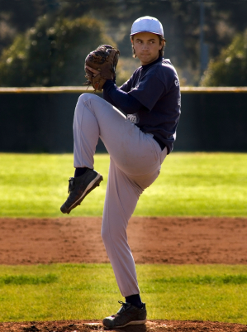
6-1-3
Pitching from the SET POSITION
The pitching restriction
begins as soon as the pitcher
intentionally contacts
the pitcher’s plate.

Slide 19
6-1-3
Pitching from the SET POSITION
The pitcher may hold the ball in the glove or pitching hand.
With or without the ball the pitching hand shall be down at his side or behind his back.

Slide 20
6-1-3
Pitching from the SET POSITION
Before starting his delivery his entire
non pivot foot shall be in front of the line extending through the front of the pitching plate.
Pivot Foot in contact with or directly in front and within the edges of the pitching plate.

Slide 21
6-1-32
Pitching from the SET POSITION
The pitcher shall go to the set position without interruption and in one continuous motion.

Slide 22
6-1-32
Pitching from the SET POSITION
The pitcher shall come to a
complete and discernible stop
(a change in direction is not an acceptable stop)
with the ball in both hands in front of his body
and his glove at or below his chin.
Only 1 stretch may be made.
http://www.thecompletepitcher.com/pitching_mechanics.htm

Slide 23
6-1-32
Pitching from the SET POSITION
Any time prior to a delivery motion the pitcher may turn on his pivot foot or lift and jump to step with the non pivot foot towards a base while throwing or feinting to that base.
Or he may step with the pivot foot backward but must be partially within the 24" plate.

Slide 24
6-1-32
Pitching from the SET POSITION
Any time prior to a delivery motion the pitcher may turn on his pivot foot or lift and jump to step with the non pivot foot towards a base while throwing or feinting to that base.
Only after the pivot foot is clearly place on the ground he has the right to feint or throw.

Slide 25
6-1-32
Pitching from the SET POSITION
Be aware of left handed pitchers throwing prior to the pivot foot on the ground.
This would be a “Dead Ball,"
a Balk with runners.

Slide 26
Situation:
> Left handed F1 in set position, R1 on 1st, F1 steps back off with the pivot and throws to 1st without stepping .
Ruling:
Ruling: Legal as long as pivot foot
is on the ground.

Slide 27
Situation:
> R1 on 1st, with ball in glove and pitching hand down at his side, takes sign, then removes ball from glove and goes into set position.
Ruling:
Ruling: “Balk!”

Slide 28
Situation:
> R1 on 2nd, F1 stretches then sets, R1 stealing 3rd, while in contact F1 steps towards 3rd and throws to put out runner.
Ruling:
Ruling: Legal.

Slide 29
Situation:
> R1 on 1st, F1 in set position in a wide stance, he lifts his non pivot foot to shorten stance, then returns to wide stance, during his stretch and before his stop.
Ruling:
Ruling: Legal.
After the pitcher becomes set
it would be a Balk.

Slide 30
Situation:
> R1 on 1st, F1 stretches and without stopping steps and throws to first.
Ruling:
Ruling: Legal. Stopping is only required before a pitch.

Slide 31
Situation:
> Right handed F1 assumes the set position as a left handed pitcher to keep R1 close @ 1st.
Ruling:
Ruling: "Balk"

Slide 32
Situation:
> With runners on, F1 from the set position and both hands in front of his body comes to a stop over top his head.
Ruling:
Ruling: “Balk.”
The pitcher must come set
with his glove at or below his chin.

Slide 33
Situation:
> R1 on 3rd, R2 on 1st, F1 in contact with rubber and not yet set, brings hand to mouth and distinctly wipes.
Ruling:
Ruling: “Balk.” The pitcher must go to set in one continuous motion.
Awards: R1, home; R2, 2nd base.

Slide 34
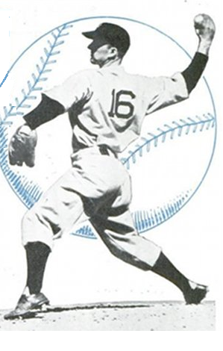
NEMOA Baseball
Pitching
Infractions

Slide 35
Pitching Infractions:
a) Applying a foreign substance to the ball. (dirt, spit, sweat, Vaseline, etc.)
b) Spitting on the ball or glove.
c) Rubbing the ball on the glove, clothing or person, if it defaces the ball.
d) Discoloring the ball with dirt.
Penalty: "Dead Ball.“ (Replace the ball.)
The pitcher may be ejected. (Umpire’s Judgment.)

Slide 36
Pitching Infractions:
e) Bringing the pitching hand in contact with the mouth without distinctly wiping off the pitching hand before it touches the ball.
Penalty: Ball on the batter
for each occurrence

Slide 37
Pitching Infractions:
f) Wearing any items on the hands, wrists or arms that may be distracting to the batter.
g) Wearing or placing tape, bandages or other foreign material (other than rosin) on the fingers or palm of the pitching hand that could contact the ball.
Penalty: Must be corrected
before next pitch.

Slide 38
Pitching Infractions:
h) Wearing a glove/mitt that includes the colors white or gray.
I) Wearing exposed undershirt sleeves that are white or gray.
Penalty: Must be corrected
before next pitch.

Slide 39
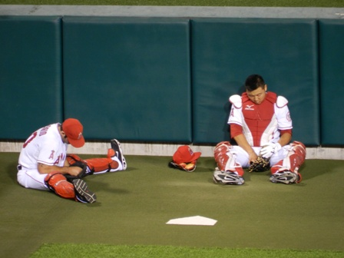
NEMOA Baseball
Delay
Of
Game

Slide 40
DELAY of GAME:
> Throwing to players other than the catcher with bases empty and batter in box.
Ruling:
Penalty: Pitcher warning, then ejection

Slide 41
DELAY of GAME:
> Consuming time conferring with defensive players who have talked with coaches after 3 charged conferences.
Ruling:
Penalty: Pitcher shall be removed as pitcher for remainder of the game.

Slide 42
DELAY of GAME:
> Failing to make a pitch, attempt a play or a legal feint within 20 seconds after receiving the ball.
Ruling:
Penalty: Batter shall be awarded
a ball.

Slide 43
DELAY of GAME:
> Warm up pitches: The starting pitcher and relief pitcher may have 8 warm ups within 1 minute from the time of the first throw..
> Subsequent innings the pitcher may warm up using 5 pitches within 1 minute from time of the 3rd out of the previous inning.

Slide 44
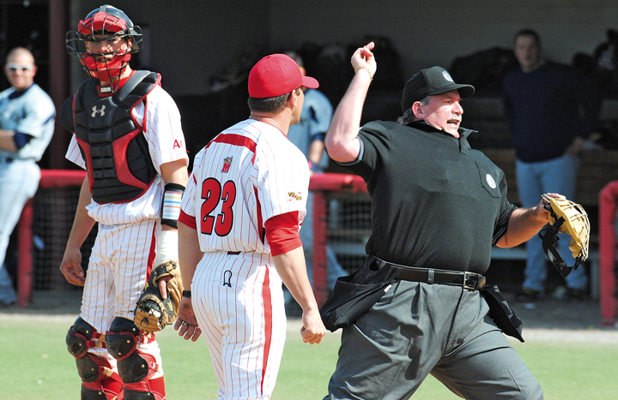
DELAY of GAME:
> Intentionally pitch close to or hit a batter with a pitched ball.
Ruling:
Penalty: If in the umpire’s judgment it is intentional the pitcher is ejected from the game.
If there is suspicion or doubt, warn both teams and eject on next occurrence by either team.

Slide 45
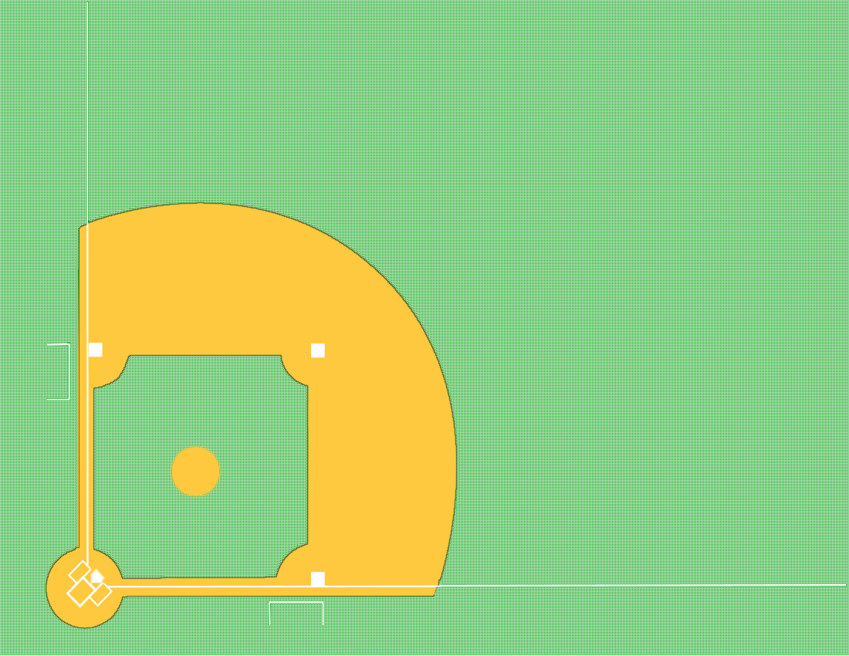
That’s
a
BALK

Slide 46
With runner(s) on
and the pitcher in contact with the rubber:
The pitcher feints toward the batter or first base.
“BALK”
Runners advance one base.

Slide 47
With runner(s) on
and the pitcher in contact with the rubber:
Dropped ball ( intentional or unintentional) that doesn't cross the foul line.
“That’s a BALK!”
Runners advance one base.
With no runners on, it’s nothing as long as the pitch happens with in 20 seconds.

Slide 48
With runner(s) on
and the pitcher in contact with the rubber:
Failing to step with the non-pivot foot directly towards a base (occupied or unoccupied) when throwing or feinting in an attempt to put out or drive a runner back.
“BALK”
Runners advance one base.

Slide 49
With runner(s) on
and the pitcher in contact with the rubber:
Make an illegal pitch from any position.
“BALK”

Slide 50
With runner(s) on
and the pitcher in contact with the rubber:
Failure to pitch to the batter in a continuous motion after his initial move commits him to pitch. (T.O.P)
“That is a BALK!”

Slide 51
If the pitcher stops or hesitates in his delivery because the batter steps out of the box
a) with one foot
b) holds his hand up and requests "time"
If pitcher legally delivers the ball
it shall be called a “strike”
regardless of location.

Slide 52
If the pitcher stops or hesitates in his delivery because the batter steps out of the box
a) with both feet
A “strike” will be called on the batter
for Delay-of-Game.
If pitcher legally delivers the ball
it shall be called yet another “strike”
regardless of location.

Slide 53
With runner(s) on
and the pitcher in contact with the rubber:
Failing to pitch, throw or feint to 2nd base after non-pivot foot passes behind the perpendicular plane of the back edge of the plate.
“That is a BALK!”

Slide 54
A “BALK” will be called:
The pitcher is on or astride the rubber without having the ball,

Slide 55
A “BALK” will be called:
The pitcher is
within 5 feet of the rubber without having the ball,

Slide 56
A “BALK” will be called:
The pitcher makes
ANY movement
associated with pitching.

