Slide 2

NEMOA Baseball
2013
Baseball Umpire Training
PowerPoint created by John Hickey, 2012

Slide 3
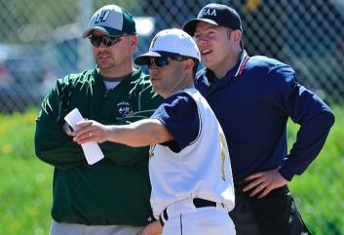
Baseball Umpire Training
Rule four
Starting and Ending a Game

Slide 4
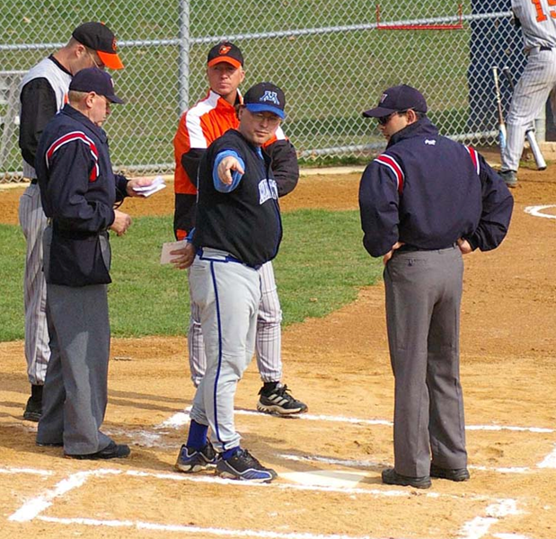
Starting and Ending a Game
4.1.1 The home coach decides whether the grounds and other conditions are suitable to start the game.
After the game starts (Rule 1.2.1- once line-ups become official, exchanged, verified and accepted by the U.I.C., during the pregame conference,) the Umpires have complete autonomy as to whether conditions are fit for play.

Slide 5
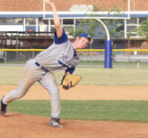
Starting and Ending a Game
4.1.2 If there are unusual conditions (spectators, obstacles,) the home coach shall propose special ground rules; if agreed upon by the visiting team, these rules will be enforced. If agreement cannot be reached or are unacceptable, then the U.I.C. shall formulate ground rules. .
All special rules shall be announced. No ground rules may supersede NFHS rules.

Slide 6
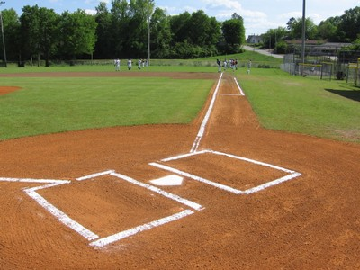
Starting and Ending a Game
4.1.2 a The field should be clearly marked to include foul lines along with a foul pole 300’ from home plate. Boundaries marking in play can be a fence or temporarily marked lines.

Slide 7
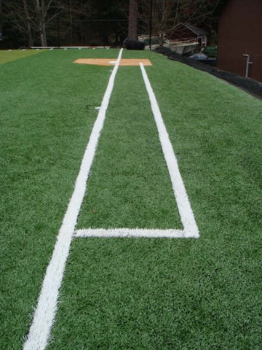
1.2.2
Non-permanent lines
(foul and in play)
Shall be white and of a material not injurious to eyes or skin.
Lime or any other caustic material is prohibited.
Permanent lines may be any color.
The game may be played
even if the field
is not in compliance with this rule.
However
at the conclusion of the game,
a memo should be sent to the NEMOA Baseball VP
and forwarded to the home field school’s AD.

Slide 8
4.1.2 b When a fair or foul fly comes down near the stands or fence, 7-4-1d applies, i.e. spectator reaches into fair territory and prevents a catch, “Dead Ball, Batters Out”.

Slide 9
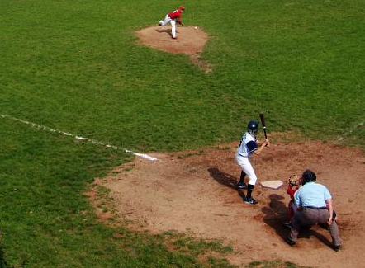
4.1.2 c If the field has unusual obstructions, ground rules should as nearly as possible be similar to rule 8.3.3,
i.e. wild pitch, overthrows and batted balls that go over through or wedge in fence, or other obstruction.
Wild pitch: one base off the rubber.
Overthrows: two bases either from time of pitch or time of throw; further discussions rule 8, base running.
Batted Balls: ground rule double; further discussions, rule 7, batting.

Slide 10
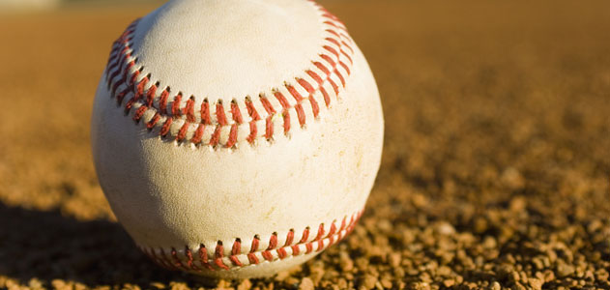
4.1.2 d If there are field obstructions where it becomes difficult for fielders to retrieve the ball, these shall be dead ball areas (established in pre-game) and batter awarded 2 bases, as are runners, from time of pitch.

Slide 11
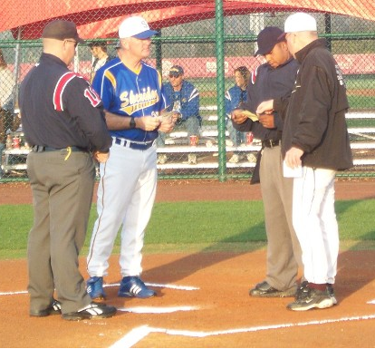
The PreGame Conference
4.1.3 Prior to game time (5 minutes) the home and visiting teams should deliver starting lineups in duplicate to the U.I.C.
The U.I.C. then allows each coach and team captains to inspect the opposing team’s line-up,
Rule 1-2-1 (Lineups become official after they have been exchanged, verified and accepted by the Umpire In Chief during the pregame conference.)
Note: At the time lineups are exchanged all starters must be at the field. The substitute regulations (Rule 3) are in effect.

Slide 12
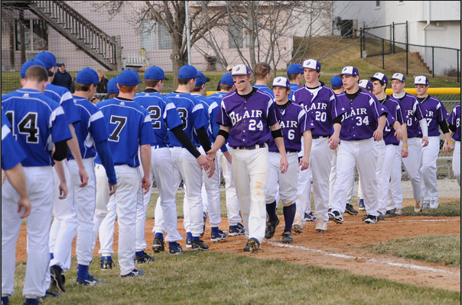
Emphasize SPORTSMANSHIP
4.1.2d Emphasize to both coaches and captains that all participants are to exhibit good sportsmanship throughout the game.

Slide 13
