Slide 1

NEMOA Baseball
2013
Baseball Umpire Training
PowerPoint created by John Hickey, 2012

Slide 2
Baseball Umpire Training
Rule Three
Subs, Coaches,
Conduct and Conferences

Slide 3
Baseball Umpire Training
Rule 3
3.1.1
Once the line-up is exchanged and approved by the U.I.C., it is official and the rules of substitution apply.
Substitution/ reentry is official when the ball becomes live- when the umpire says, “Play.”
Unreported substitutes become official when the U.I.C. says, “Play.”
If the umpires are not aware of a prior substitution or re-entry they cannot make a judgment.
An offensive illegal substitute is out immediately and restricted to the dugout upon discovery by either the defense, offense or umpires.
Note: A pitch or play does NOT legalize an illegal player.

Slide 4
Baseball Umpire Training
Rule 3
3.1.1
Actions created by an illegal batter are nullified, the batter is out and restricted to the bench; runners return to the base occupied at T.O.P.
The penalty for an illegal substitute supersedes batting-out-of-order.
A defensive illegal substitute is replaced immediately and restricted to the bench.
“Projected” substitutions are disallowed, advise the coach to report the change at the time the substitution /re-entry takes place..
A Courtesy runner runs for the position, not the player. Note: You cannot make a defensive change while on offensence in an attempt to take advantage of the CR rule. A courtesy runner runs for the position/player of record of the defensive half-inning.

Slide 5
Baseball Umpire Training
Rule 3
3.1.5
Unconscious Player:
Symptoms:
Headache, dizziness, confusion or imbalance
Any player who displays symptoms
MAY NOT RETURN TO PLAY UNTIL CLEARED BY AN APPROPRIATE HEALTH-CARE PROFESSIONAL!

Slide 6
Baseball Umpire Training
Rule 3
3.2.1 Coaches are required to be in team uniform; if not properly attired, he is restricted to the dugout unless attending to a player.
3.2.2 A thrown ball that accidently hits a coach in the coach’s box or foul territory is a LIVE BALL. A thrown ball that hits a coach in fair territory is a DEAD BALL and the runner closest to home is called “out.”
3.3.1 Coaches leaving the coach’s box or the dugout to argue a call can be: warned, restricted to the dugout or ejected, depending on the severity. An assistant coach violation will also restrict the head-coach to the dugout.
3.3.1 A Thrown Bat: Intentional- Penalty: Ejection.
Unintentional- Team Warning; ejection upon repeat offender by same team.
An individual team warning is issued upon occurrence; a warning for Team A is not a warning for Team B.

Slide 7
Baseball Umpire Training
Rule 3
3.3.1 Profanity: Delayed Dead Ball. At end of playing action the offender is ejected; substitution rules apply.
3.3.1 Tobacco: Use of tobacco within the confines of the field- Delayed Dead Ball, ejection.
3.4.1 Defensive conferences are not cumulative. Each team may have three (3) charged defensive conferences per seven inning game. Each team may have no more than one defensive conference per inning during extra innings of play and may not accumulate.

Slide 8
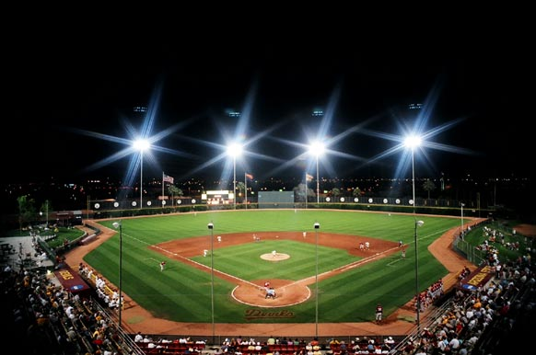

Thank you everyone.
Will the last to leave please turn out the lights?

