Slide 1

NEMOA Baseball
2013
Baseball Umpire Training
PowerPoint created by John Hickey, 2012

Slide 2
NEMOA Baseball
NEMOA
Baseball Umpire Training
Rule Two
Playing Terms & Definitions

Slide 3
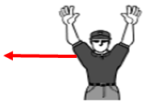
Playing Terms & Definitions
2.2.1 Awarded Bases: this is the right to advance without
a play being made. Awarded bases must be legally
touched in order. Missed bag may be appealed by
the defense before the next play or the next pitch.
2.3.1 Balk: is an illegal act committed by the pitcher. Rule 6.
2.4.1 Ball: a pitch that is not touched by the bat or that does
not enters the strike zone.
2.4.2 Base-on-balls: aka “Walk” the batter receives four (4)
balls. Ball is alive.
2.4.3 Intentional base-on-balls: given to the batter at the
request of the catcher or defensive coach. Ball is dead.

Slide 4
Playing Terms & Definitions
2.5.1 Fair Ball is a batted ball which:
a) batted ball that settles on fair territory between home and
first or home and third base,
b) batted ball that contacts fair ground on or beyond an
imaginary line between first and third base,
c) batted ball that is over fair ground bounding to the
outfield past first or third base,
d) batted ball that falls into fair ground beyond first or third
base,
e) batted ball that touches first or third base.
2.7.2 Batters Box: 4’ x 6’ area in which the batter stands while batting.
The lines are part of the box.
A batter’s foot on the line is in the box.

Slide 5
Playing Terms & Definitions
2.9.1 Catch: the catch of a fly ball isn’t complete until the continuation
action of the catch is complete.
A fielder @ full speed who catches a ball and whose initial
momentum carries several more steps after which the ball drops
from his glove has not made a catch.
A fielder by his action of stopping and removing the ball with his
throwing hand has made the catch.
The ball dropping out of throwing hand on the transfer is still a
catch.
This definition also applies at the front end of a double play; the ball
dropped on the transfer is just that, the ball was controlled in the
glove therefore the runner is out.
If a fielder has control (not juggling) when he goes out of bounds
it’s a catch and an “OUT.”

Slide 6
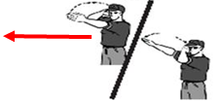
Playing Terms & Definitions
2.9.3 Catchers Box: measures 43” x 8’
2.16.2 Foul Tip: is a batted ball that goes directly
to the catcher’s hands and is legally caught
by the catcher.
A batted ball hitting catcher’s body then caught in hands is a “foul ball”

Slide 7
Rule 2-16-2 Definition of a Foul Tip
Foul Tip:
Struck ball must go directly to the catcher’s hand or mitt.
Can only be caught by the catcher.
A strike is added to the batter’s count.
Ball remains in play.

Slide 8
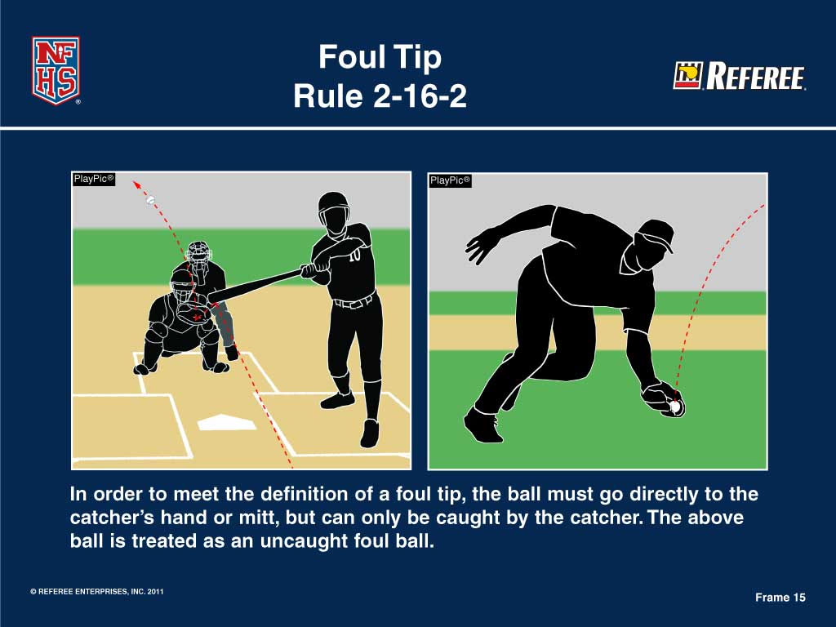

Slide 9
Rule 2-16-2 Definition of a Foul Tip
The bunt does not go directly to the catcher’s glove, so this act does not meet the definition of a foul tip.
The ball was caught before it hit the ground and is a foul pop-up.
Any defensive player can catch the ball and it will be registered as an out.

Slide 10
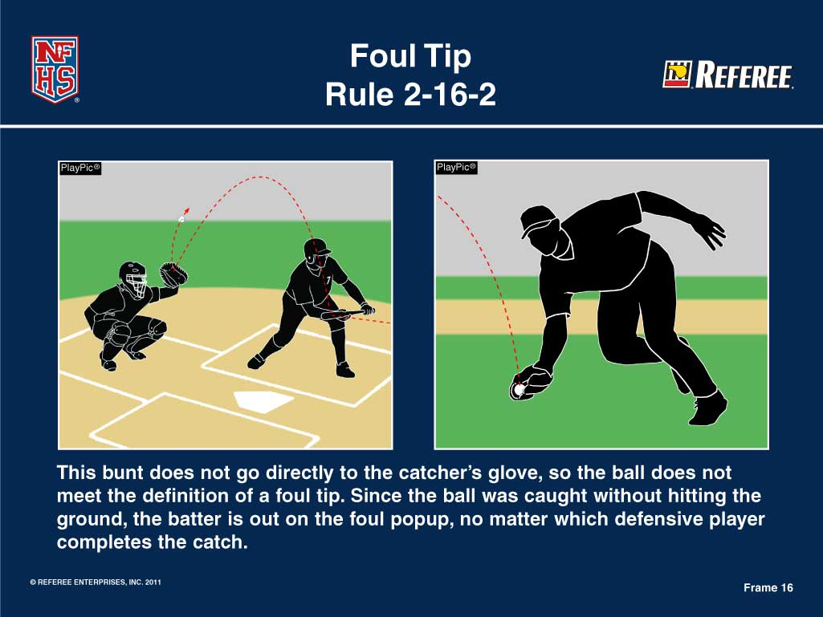

Slide 11
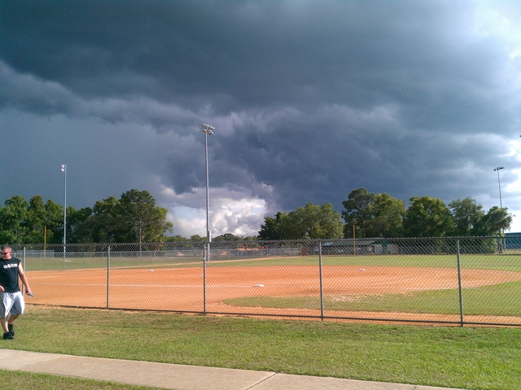

Lightning Safety
Lightning poses a huge threat for baseball participants.
Suspend play for a minimum of 30 minutes from the last occurrence of lightning or thunder.

Slide 12
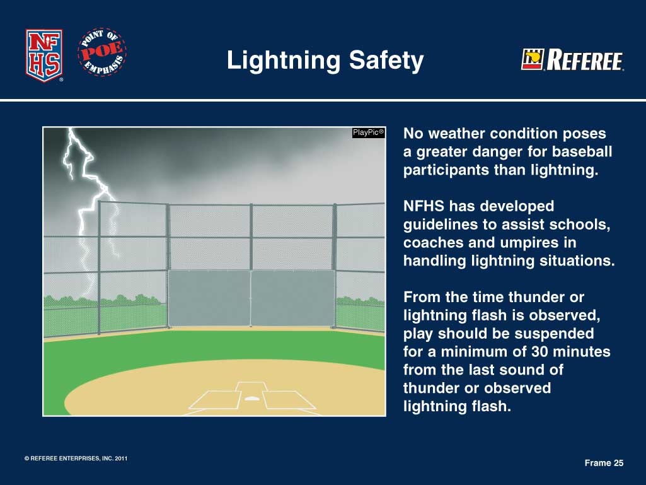

Slide 13

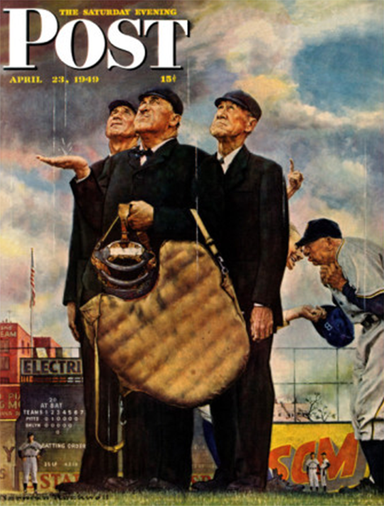
We’re
outa’
here.

