Slide 1

NEMOA Baseball
Baseball Umpire Training
PowerPoint created by John Hickey, 2012

Slide 2
Baseball Umpire Training
Rule One
Players, Field and Equipment

Slide 3
Baseball Umpire Training
LINE-UP CARDS

Slide 4
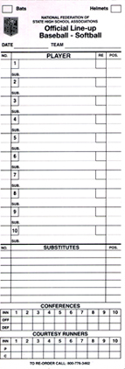
1.1.2
The LAST NAME
and jersey number
for all starters and subs
shall be listed
on the line-up card.
Aparicio 6
Blair 8
3 Blefary 7
27 Bunker 1
1 Hickey 4
16 Powel 3
21 Guinivan 2
4 Green 9
5 Robinson 5
8 Novak
Laird
Pierce
Blaha

Slide 5
1.1.2
Starter’s position
shall also be listed.
Aparicio 6
Blair 8
3 Blefary, Curt 7
27 Bunker, Wally 1
5 Robinson

Slide 6
1.1.2
The U.I.C.
shall not accept
the lineup card
until all substitutes
are listed.
(No Penalty.)
Aparicio 6
Blair 8
3 Blefary 7
27 Bunker 1
5 Robinson

Slide 7
1.1.2
The Batting-out-of-order rule requires that only the last name be in proper order.
If there are duplicate last names ask for a first initial.
This will improve the pace of the
game and accuracy of record keeping.
Aparicio 6
Blair 8
3 Blefary 7
27 Bunker 1
20 Robinson, F 9
5 Robinson, B

Slide 8
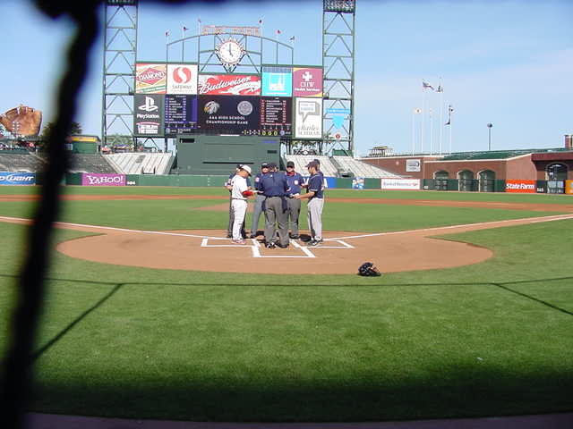
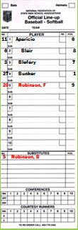
1.2.1 Lineups become official
after they have been
exchanged and verified
and then accepted by
the Umpire In Chief
during the pregame conference.

Slide 9
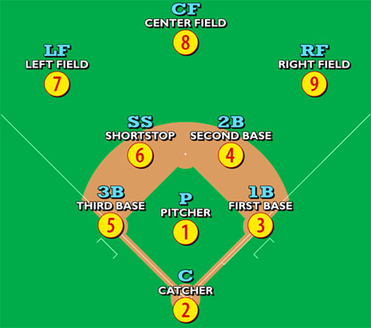
1.1.3
All defensive players
must be in play
at the time of the pitch.
Penalty:
Illegal Pitch.
By definition
and interpretation
at least one foot
must be in fair territory
to comply.
Note:
On the line is in fair territory.

Slide 10
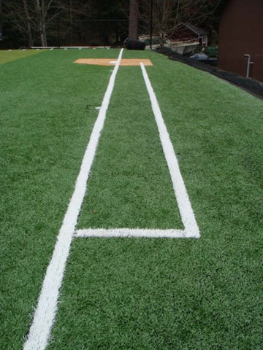
1.2.2
Non-permanent lines
(foul and in play)
Shall be white and of a material not injurious to eyes or skin.
Lime or any other caustic material is prohibited.
Permanent lines may be any color.
The game may be played
even if the field
is not in compliance with this rule.
However
at the conclusion of the game,
a memo should be sent to the NEMOA Baseball VP
and forwarded to the home field school’s AD.

Slide 11
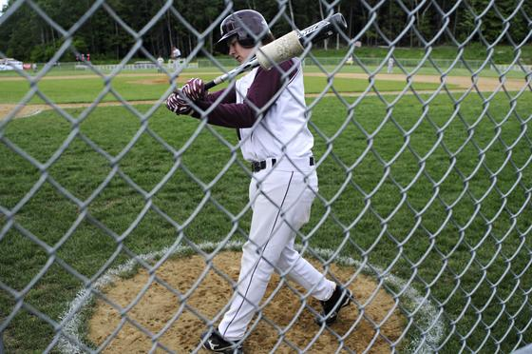
1.2.3 The On-Deck Circle should be to the side and away from home plate.
(37 ft. if space allows.)
Neither team’s players should warm-up in the other team’s on deck circle.

Slide 12
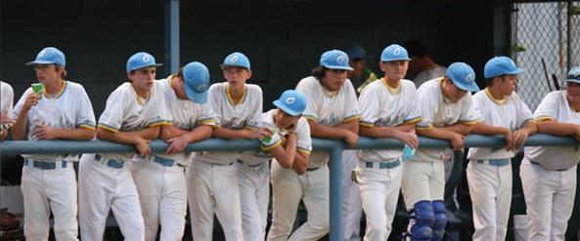
1.2.4 The Dug-Out may be TEMPORARILY EXTENDED
provided the following:
Extended only toward the outfield on a line parallel to the foul line
And equally applied for both teams.

Slide 15
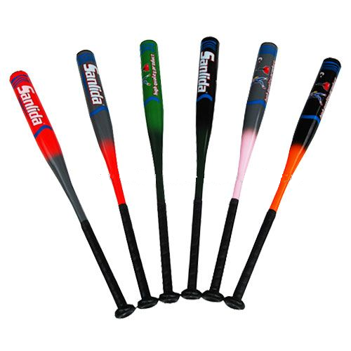
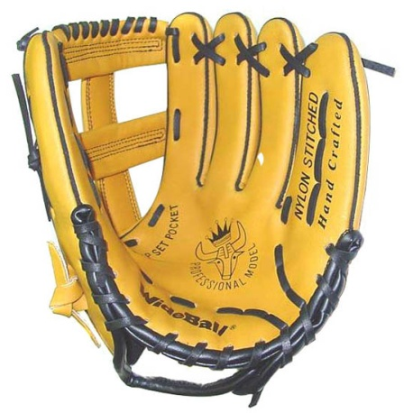
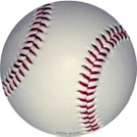
BATS
GLOVES
Rule 1
Section 3
BATS,
GLOVES,
BALLS
BALLS

Slide 16
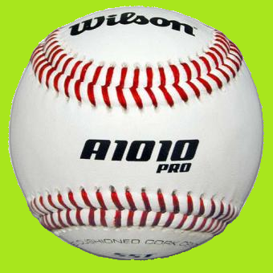
1.3.1 The Home Team (or game management)
shall provide a minimum of three (3) umpire approved
(w/ NFHS Authenticating Marking )
baseballs to start the game.
Keep the pace of the game by advising the home team coach when only one ball is remaining in the ball-bag.
5- 5¼ oz. 9- 9¼” circumference Coefficient-of-Restitution (COR) </= .555

Slide 17


1.3.2a Two Possibilities for BATS:
Wood* (100% wood construction, max. 2 ¾ “ barrel, max 36” length)
*BBCOR not required
Non-wood (aluminum / composite)
Non-wood bats must have a silk-screen or permanently marked

Slide 18
1.3.2b Bamboo is not wood
1.3.2g -With the 1st illegal bat offense, the coach is restricted to the
bench
-Upon 2nd offense, the coach is ejected
-Upon the 3rd offense the acting coach is ejected
PENALTY: The batter is out for violating rule 4.1.3b (illegal bat)
The batter is out- but not ejected.
Also, Rule 7.4.1a applies: If the infraction is discovered at the conclusion of a play but before the next pitch, the defense may take the out or the result of the play.
1.3.2c Only the barrel is required to be round, symmetric and smooth
1.3.2d Any bat not solid wood is considered non-wood and is subject
to BBCOR requirements
1.3.2e Bats marked BESR are illegal bats.

Slide 19
1.3.2e Post-production stickers are not allowed (illegal).
1.3.4 Only bats may be used for warming up and may include a
batting donut, wind resistant devices, or weighted bats
1.3.5 Bats subject to Rule 4.1.3b Prohibited:
- altering bats from the manufacturer's original design
- using an artificial means to alter a bats temperature
- foreign substance inserted into a bat
- broken bat
- bat that cuts the ball

Slide 20
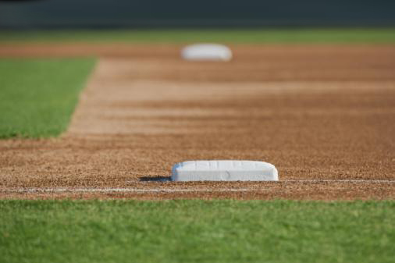
More about BATS...
...Definitions...

Slide 21
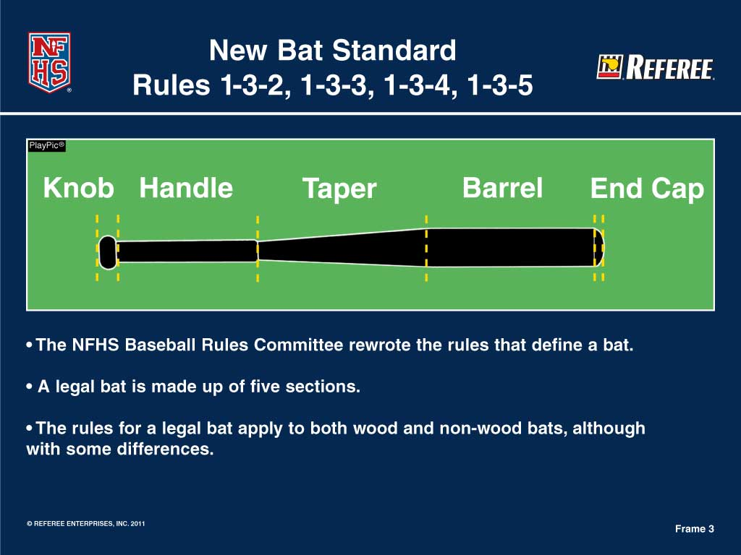

Slide 22
Rule 1-3-2 Definition of a Baseball Bat
Legal wood, aluminum or composite bats shall:
Be one piece, multi-pieces, permanently assembled or two pieces with interchangeable barrel construction;
Not have exposed rivets, pins, rough or sharp edges or any form of external fastener that would present a hazard;
Be free of rattles, dents, burrs, cracks, sharp edges;
Bats that are broken, altered or deface the ball are illegal.
Notes:
In order to fully make an impact in bat rules for now and in the future, the committee had to break down the various sections of a baseball bat. We recognize only three types of bats, one-piece solid wood, aluminum alloy and composite (which is made up of two or more materials) bats. The distinctions apply to both solid wood and non-wood bats. However, there are some differences between both products.
22

Slide 23
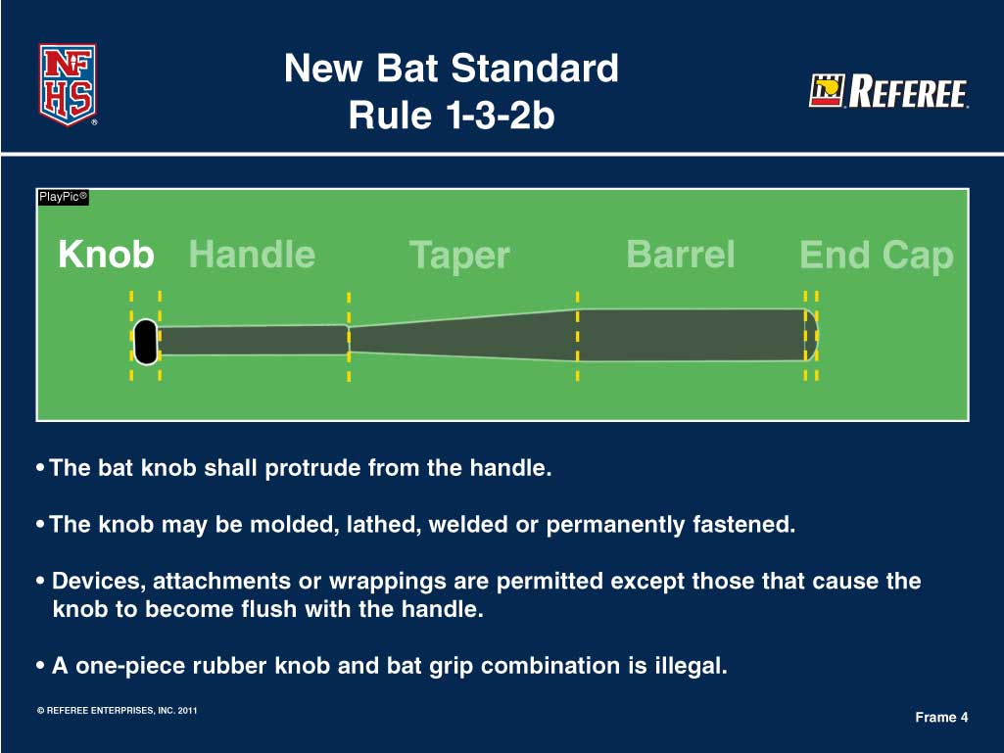

Slide 24
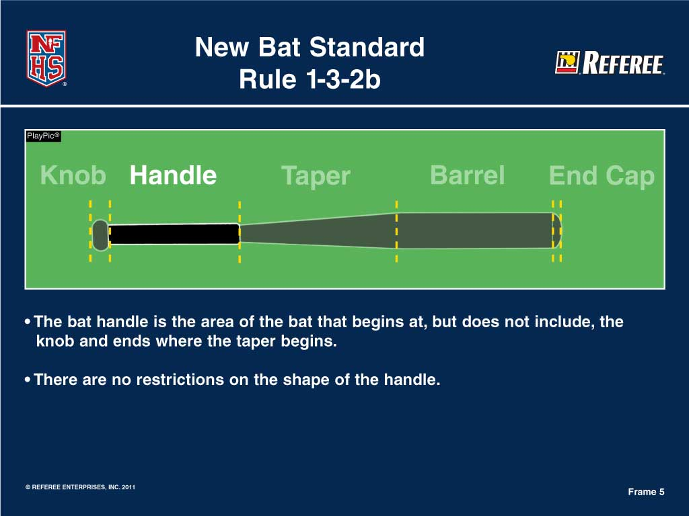

Slide 25
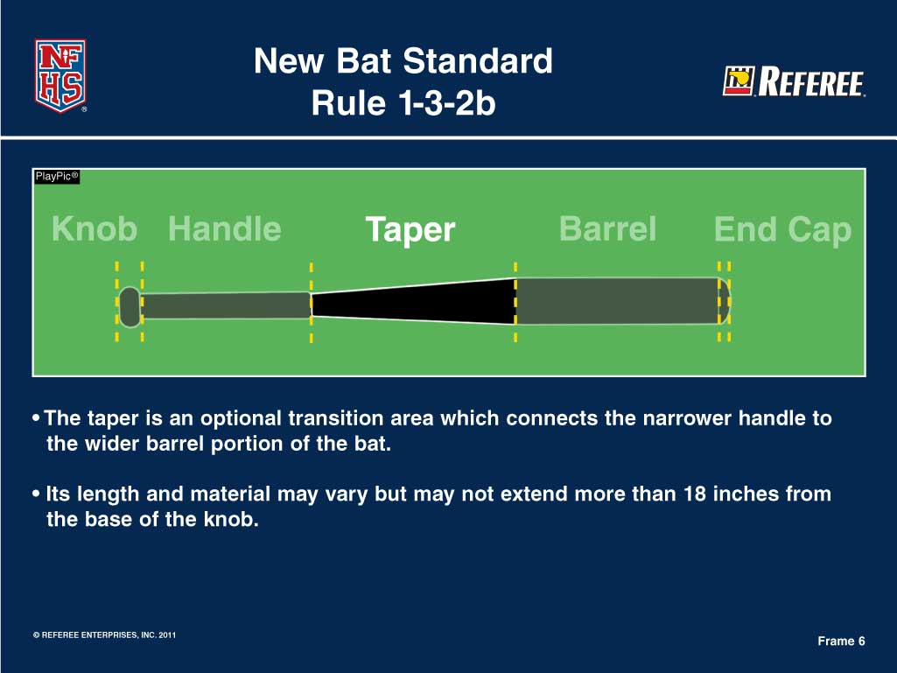

Slide 26
Rule 1-3-2b Definition of a Baseball Bat
Taper
Optional transition area which connects the narrower handle to the wider barrel portion of the bat.
Tapers are not required to be smooth or round and permitted to have holes and geometric shapes.
Notes:
The taper has gone through a metamorphosis over the past several years and proved to be problematic for umpires, coaches and the bat purchasing public. By addressing the taper issue the definition is cleaner and provides much more guidance than in the past.
26

Slide 27
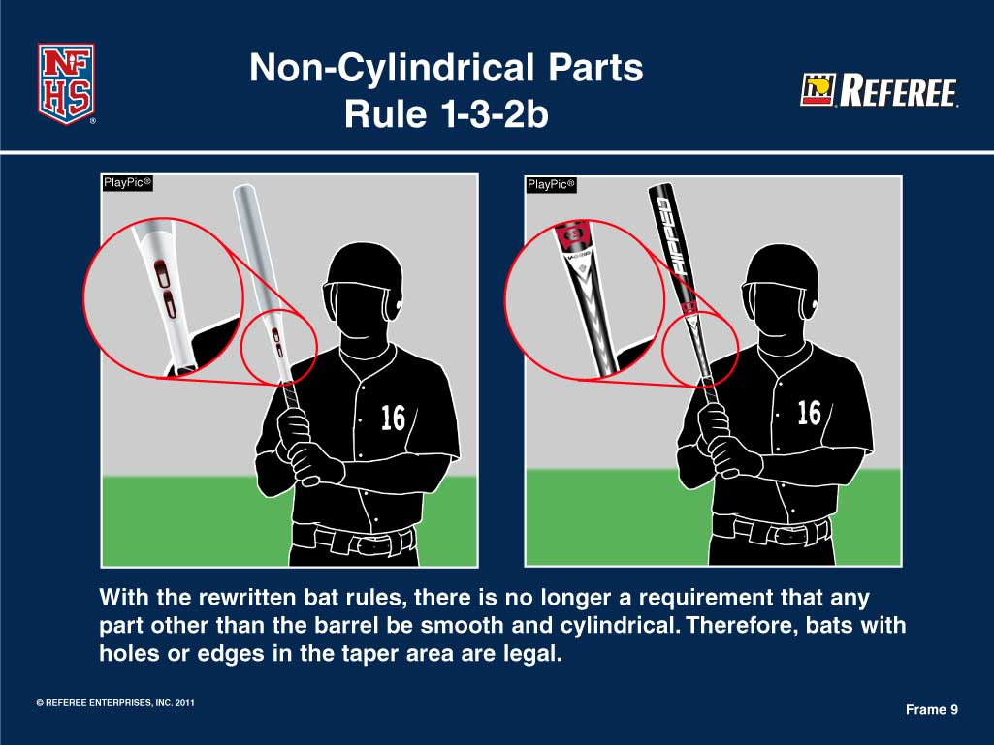
Notes:
27

Slide 28
Rule 1-3-2b Definition of a Baseball Bat
Taper
Length and material may vary but may not extend more than 18” from the base of the knob.
Notes:
Tapers are not required to be smooth or round and permitted to have holes and geometric shapes.
28

Slide 29
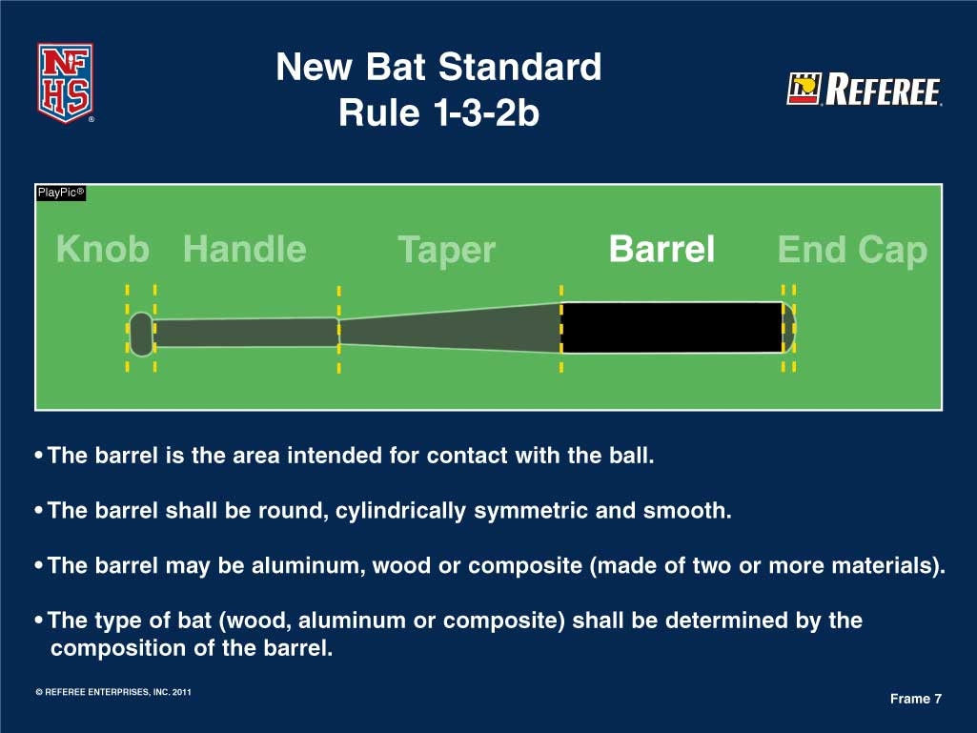

Slide 30
Rule 1-3-2b Definition of a Baseball Bat
Barrel
The area intended on the bat for contact with the ball.
The barrel shall be round, cylindrically symmetric and smooth.
The barrel may be wood, aluminum or composite (made of two or more materials).
The type of bat (wood, aluminum, composite) shall be determined by the composition of the bat’s barrel.
Notes:
This is a huge distinction from the past and in lieu of creative bat manufacturers, this is a very key point. Multi-piece bats that have a composite handle and an aluminum barrel are categorized as an aluminum bat.
30

Slide 31
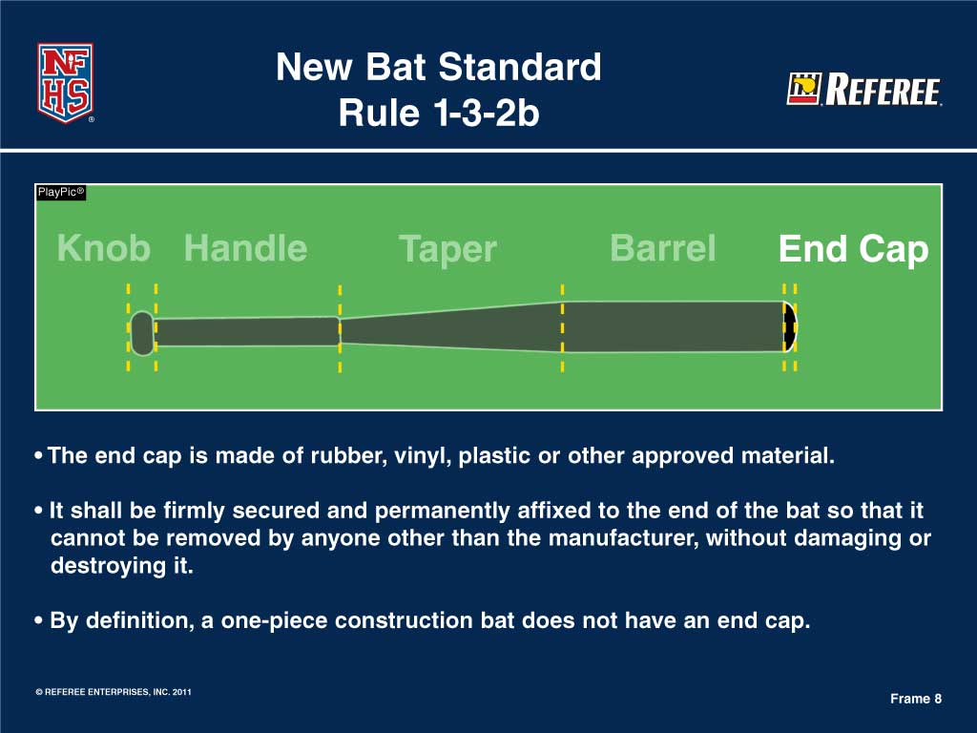

Slide 32
Rule 1-3-2b Definition of a Baseball Bat
End Cap
Can be manufactured in rubber, vinyl, plastic or other approved material
Shall be firmly secured and permanently affixed to the end of the bat so that it cannot be removed by anyone other than the bat manufacturer without damaging or destroying the bat.
A one-piece construction bat does not have an end cap.
Notes:
Found on the end of the bat nearer the barrel.
32

Slide 33
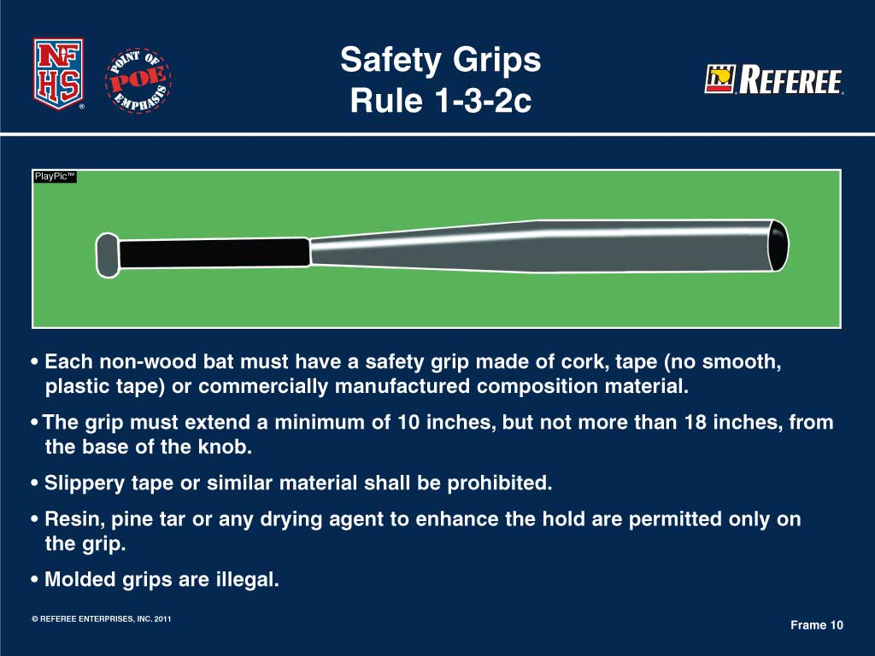
Notes:
33

Slide 34
Rule 1-3-2c Definition of a Baseball Bat Safety Grips
Each non-wood bat must have a safety grip made of cork, tape (no smooth or plastic tape) or commercially manufactured composition material.
The grip must extend a minimum of 10”, but not more than 18” from the base of the knob.
No slippery or similar material will be allowed.
Resin, pine tar or any other drying agent to enhance the hold are permitted on the grip only.
Molded grips are illegal.
Notes:
The definition of a safety grip has not change but the entire rules article was rewritten to include the introduction of new and creative drying agents to the known commodities such as resin and pine tar.
34

Slide 35
Legal Bats for the 2012 Season
Note: Only baseball bat manufacturers can apply for and receive a waiver from the NFHS.
Any aluminum or composite bat that meets the January 1, 2012 specifications found in Rule 1-3-2e.
Notes:
Since the NCAA had a January 1, 2011 implementation date for BBCOR bats, we anticipate that there will be some products available during the late fall/early winter for the upcoming baseball season.
35

Slide 36
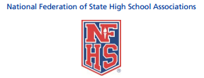
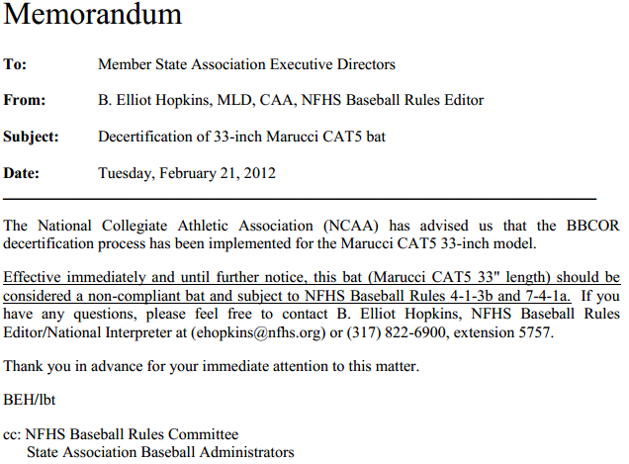
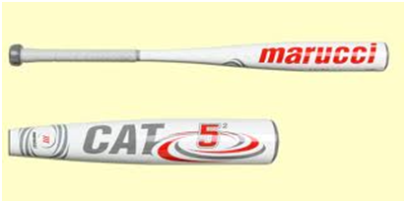

Slide 37
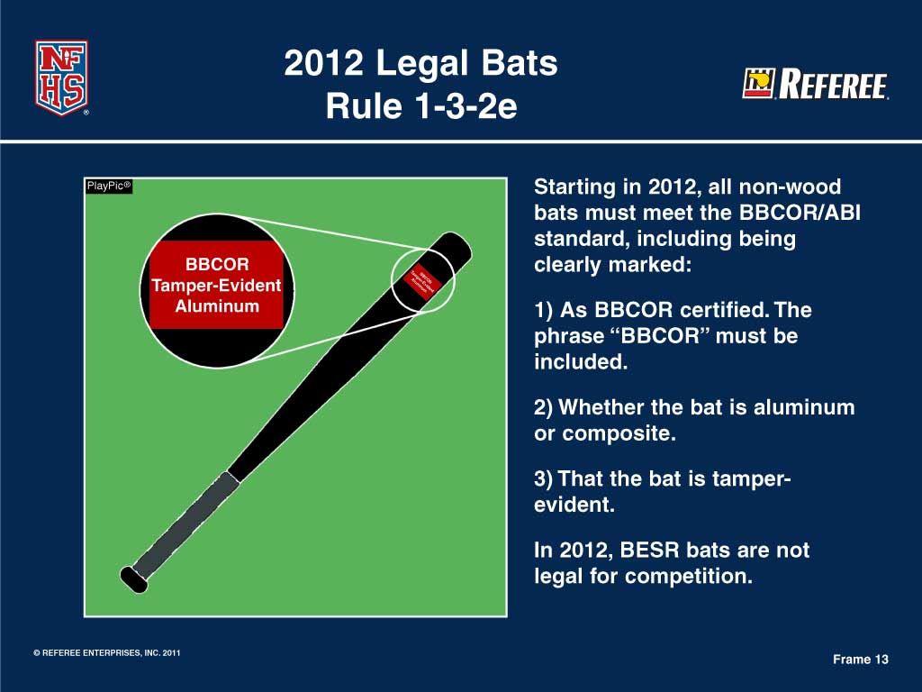

Slide 38
Rule 1-3-2e Baseball Bat Rule
#1 All non-wood bats must meet the Batted Ball Coefficient of Restitution (BBCOR) and Accelerated Break-In (ABI) performance standard.
BBCOR certification is labeled on the barrel of the bat with a silkscreen or other permanent certification mark, which shall be rectangular, a minimum of a ½” on each side of the barrel of the bat in any contrasting color.
Notes:
Non-wood bats would be immediately in compliance during the 2011 season if they meet the three step criteria of Rule 1-3-2e.
38

Slide 39
Rule 1-3-2e Baseball Bat Rule
#2 The composition (aluminum or composite) of the non-wood bat must be clearly labeled on the barrel of the bat with a silkscreen or other permanent certification mark, which shall be rectangular, a minimum of a ½” on each side of the barrel of the bat in any contrasting color

Slide 40
Rule 1-3-2e Baseball Bat Rule
#3 Aluminum and composite bats shall be labeled tamper evident with a silkscreen or other permanent certification mark, which shall be rectangular, a minimum of a ½” on each side of the barrel of the bat in any contrasting color.

Slide 41
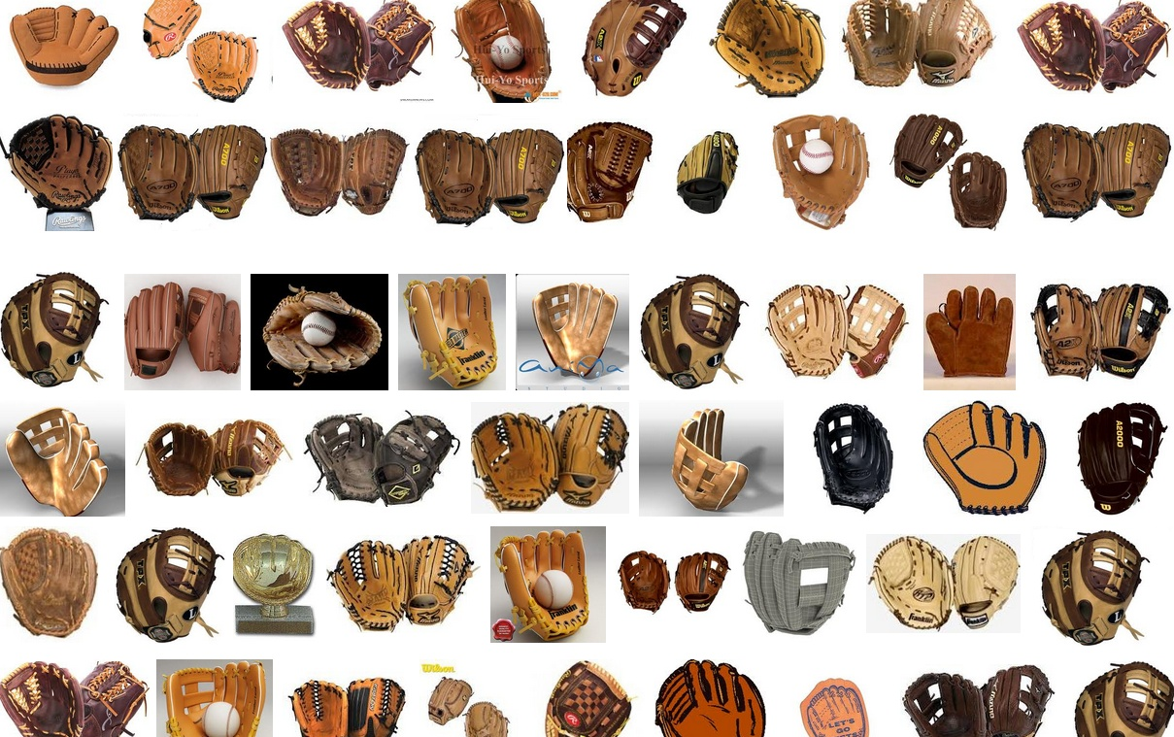
GLOVES & MITTS

Slide 42
1.3.6 Gloves/ Mitts Made of leather shall be worn by all fielders and not be altered create an adhesive, sticky and/or tacky surface.

Slide 43
1.3.6 Gloves/ Mitts Made of leather shall be worn by all fielders and not be altered create an adhesive, sticky and/or tacky surface.
Multi-colored gloves are allowed, except the pitcher’s may not include either white or gray.

Slide 44
1.3.6 Gloves/ Mitts Made of leather shall be worn by all fielders and not be altered create an adhesive, sticky and/or tacky surface.
Multi-colored gloves are allowed, except the pitcher’s may not include either white or gray.
Exception: Any glove ruled distracting by the U.I.C. will be disallowed for the pitcher.

Slide 45
1.3.6 Gloves/ Mitts Made of leather shall be worn by all fielders and not be altered create an adhesive, sticky and/or tacky surface.
Multi-colored gloves are allowed, except the pitcher’s may not include either white or gray.
Exception: Any glove ruled distracting by the U.I.C. will be disallowed for the pitcher.
The Catcher’s Mitt may be any size.

Slide 46
1.3.6 Gloves 14” maximum height
measured from the bottom center of the heal
to the highest point at the top of the mitt.

Slide 47
1.3.6 Gloves 8” maximum width
measured (horizontal line) from the edge
of the index finger at the web
to the outside edge of the little finger.

Slide 48
1.3.6 Gloves Webbing
maximum measure of 5¾”
across the top.

Slide 49
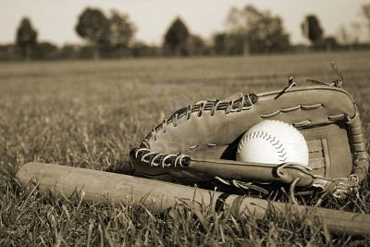
1.3.7 Loose Equipment
Gloves, bats, helmets, catcher’s gear that interferes with play may not be on the field.
PENALTY: The Umpire may call outs, advance or return runners, based on circumstances of play.
(Covered further in Rule 8 discussion.)

Slide 50
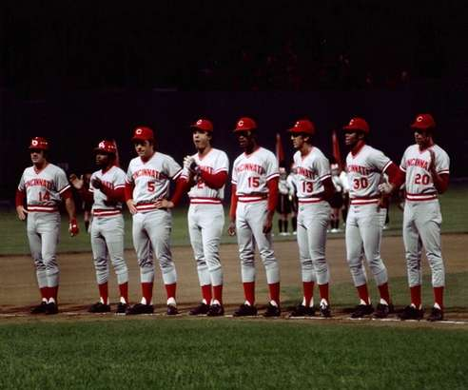
1.4.1
Uniforms shall be the same color and style.
Caps and shoes are required.
A head-protector can replace the mandatory cap.

Slide 51
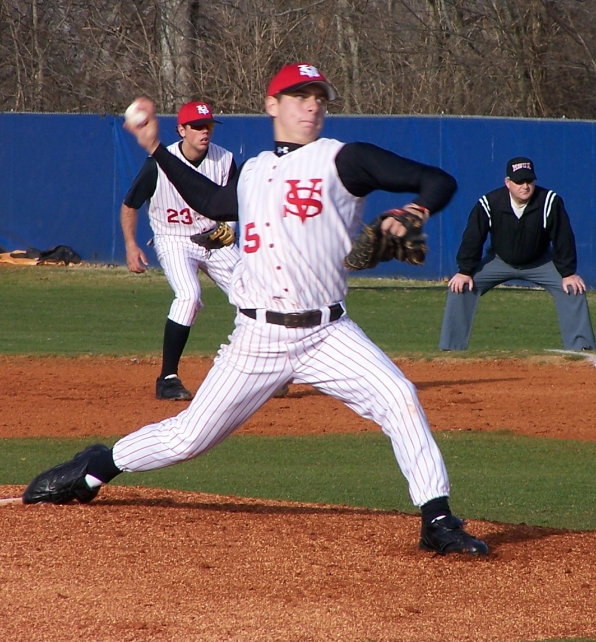

1
.
4
.
2
Shirt sleeves should not be ragged, frayed or have slits.
The pitcher cannot have exposed
white or gray undershirt.
If the uniform is white or gray, the sleeve
may not extend below the pitcher’s elbow.

Slide 52
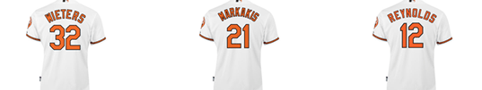
1.4.3
The number shall be contrasting to the uniform.
Numbers must be at least 8” in height.
The number border cannot exceed ¼” in width .

Slide 53
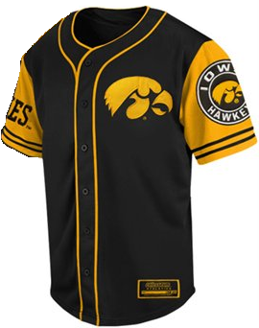

1.4.4
Logos (patches) allowed on each uniform item
(i.e. pants and jersey).
Logos must be displayed uniformly.
Logos may not exceed 2 ¼” square.
No dimension may exceed 2 ¼”.
The American Flag can be 2” x 3”.
Jackets are only allowed to be worn
in play by coaches and the pitcher while on base.

Slide 54
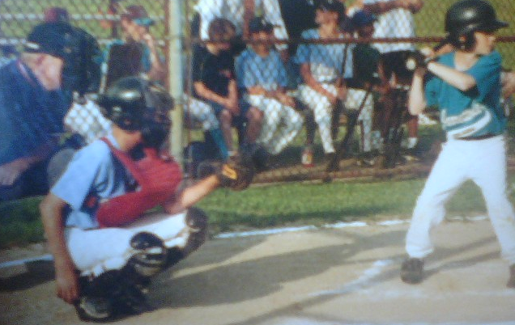
Rule 1. Section 5
Player Equipment

Slide 55
1.5.1
Wearing a HELMET
is MANDATORY for ALL
batters
runners
retired runners
players/ students in Coach’s Box
Non-adult bat/ball shaggers

Slide 56
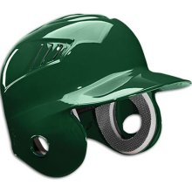

1.5.1
The
HELMET
shall have extended ear flaps covering both ears and temples
and display the NOCSAE
Stamp
National Operating Committee on Standards for Athletic Equipment
Live Ball or Dead Ball:
Non-adult ball/ bat shaggers,
equipment managers,
must wear a helmet
at all times!

Slide 57
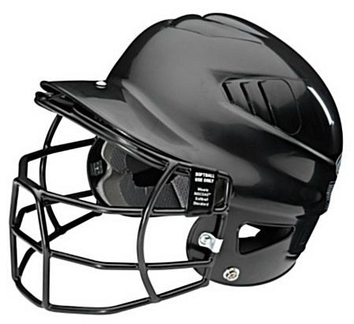
1.5.2
Face Mask
must meet the
NOCSAE
National Operating Committee on Standards for
Athletic Equipment
Standard
and must be attached
at the time of manufacture or be approved by the manufacturer.

Slide 58
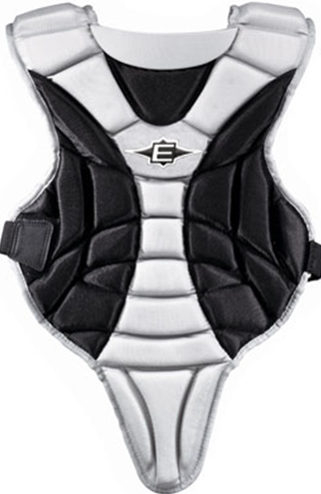
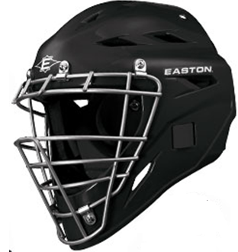
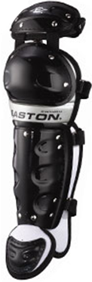
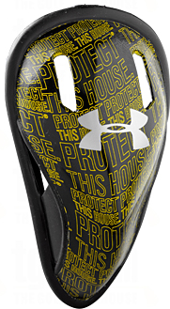
1.5.3 The Catcher shall wear:
body
protector
shin
guards
head protector
& mask
w/ throat protector
cup

Slide 59
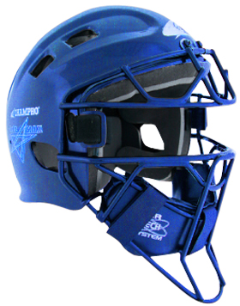
PENALTY: Failure to comply after being ordered by the umpire shall result in the ejection of the offender.
1.5.4
The Catcher’s Helmet shall meet
NOCSAE Standards with full
ear protection covering both ears and throat protector that adequately covers the throat.
Any non-adult
in a crouched position warming up the pitcher
is required to wear
head protector
w/ face mask,
throat protector,
and a cup.

Slide 60
1.5.5
Defensive players
may wear head and face protection with a
non-glare surface.

Slide 61
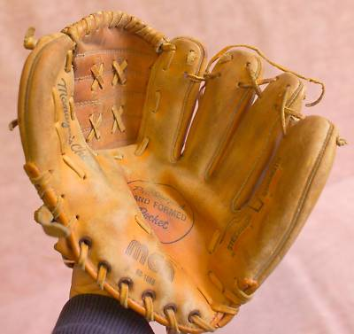
1.5.6
Defective equipment must be repaired or replace immediately.

Slide 62
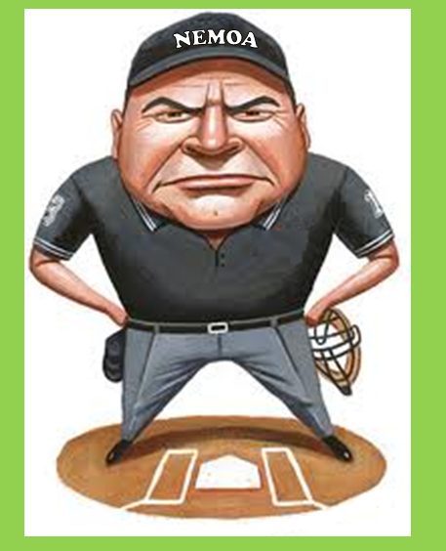
1.5.7
If it is discovered
by the umpire
that a ball has been touched
w/ an illegal glove or mitt,
the coach of the team at bat
has the option of taking the result of the play.
The illegal equipment
must be replaced immediately.
A foul fly caught w/ an illegal glove is nullified and called a foul ball unless the team at bat
decides to take the result of
the play.
This will be discussed again
in greater detail
during discussion of
Rule 8.

Slide 63
1.5.8
Guards, braces (altered from original manufactures design,)
casts, splints, etc. must be covered w/ ½” closed-cell padding.

Slide 64
1.5.9
Any equipment judged by
the umpire
to be
unreasonably dangerous
is illegal.

Slide 65
1.5.10
Any
questions regarding
the legality
of player equipment...
...shall be resolved by the U.I.C.

Slide 66

Medical alerts
must be taped
and visible.

Slide 67
Religious medals
must be taped
and worn under the uniform.

Slide 68
Any other jewelry shall not be worn.

Slide 69
1st offense- team warning to the coach.

Slide 70
On 2nd offense- offender is ejected.
Rule: 3.31d

Slide 71
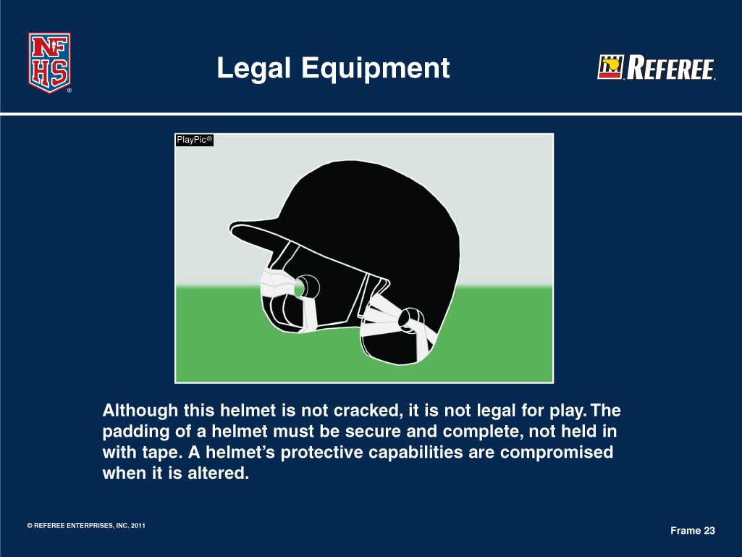

Slide 72
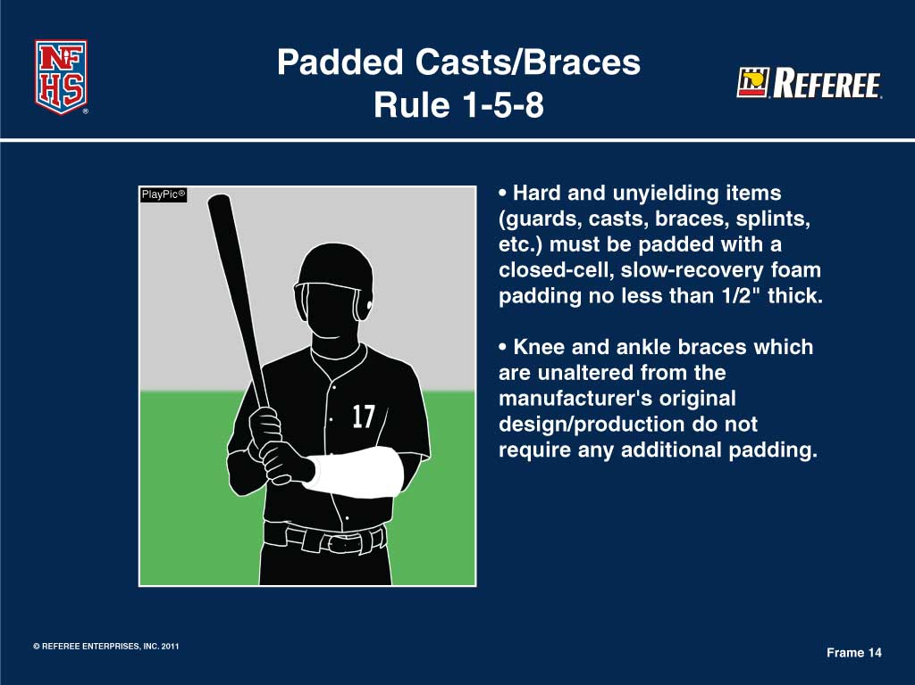

Slide 73
Rule 1-5-8 Padded Casts/Braces
Knee and ankle braces which are unaltered from the manufacturer’s original design/production do not require any additional padding.
The rule (1-4-2) still applies for the pitcher that he cannot wear any item on his hands, wrists or arms which may be distracting to the batter. That includes a cast, guard, brace, splint, etc. that is white, gray or distracting on the pitcher’s arms.
Notes:
We recommend they cover it with a colored pre-wrap or a colored cloth cover.
73

Slide 74

Thank
Youuuuuuu.....

