Slide 1

NEMOA Baseball
2012
Baseball Umpire Training
PowerPoint created by John Hickey, 2012

Slide 2
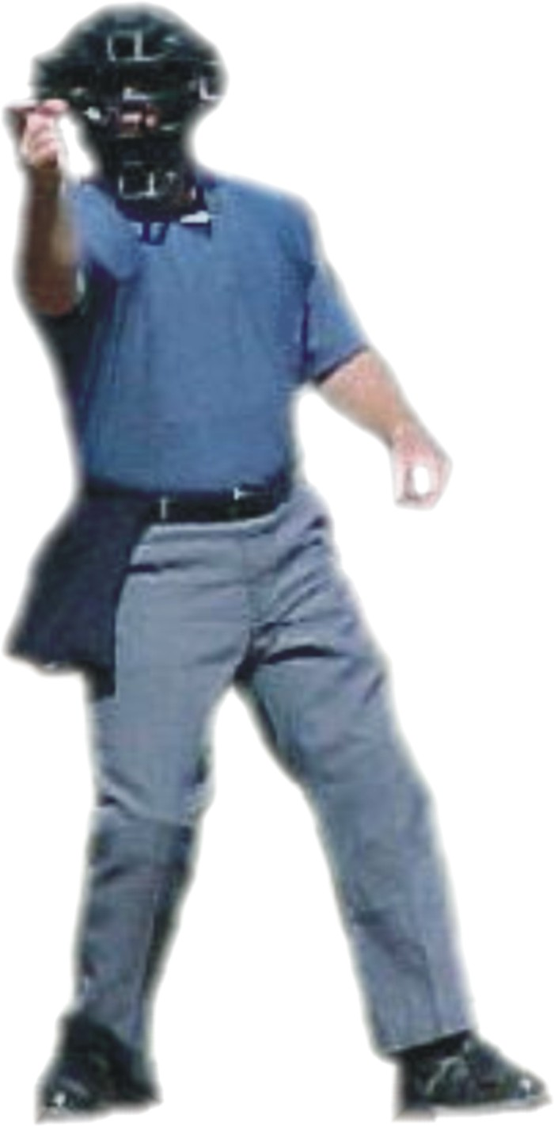
Baseball Training Presentation
You Are A Professional Umpire
Look & Act
the Part

Slide 3
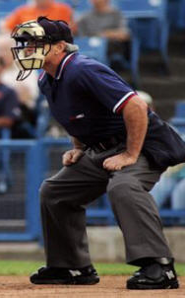
Umpire:
The only profession where you have to be perfect the first day and get better from there!

Slide 4
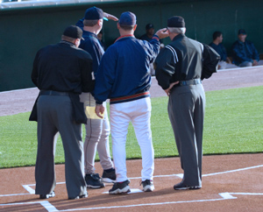
Early in his umpiring career a new umpire asked an experienced umpire for advice on umpire equipment.
His response was too ALWAYS look professional. Launder your uniform regularly and maintain your equipment so that it looks like it is all new this season.

Slide 5
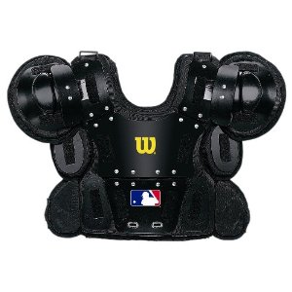
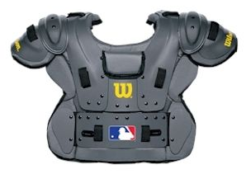
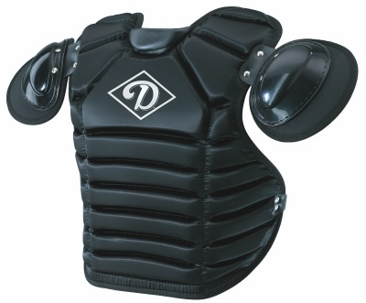
He was asked what chest protector he would recommend.
He responded,
“Would you buy a second rate bullet-proof vest?
If you are serious about umpiring, invest in the good stuff.
West vest is the best.”

Slide 6
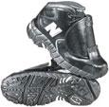
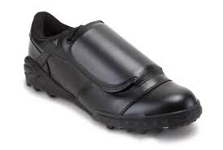
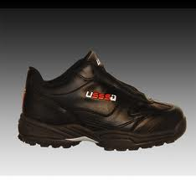
When asked about shoes...
He said, “Have you ever had a 200+ lb. catcher wearing cleats jump back onto your foot? Invest in the good stuff.
Many umpires like patent leather. The choice is yours, but the best thing you can do regarding your shoes is clean them before you drive away at the end of your game.
Don’t worry about delaying your partner; as you get into the practice, cleaning your shoes won’t take but a minute.

Slide 7
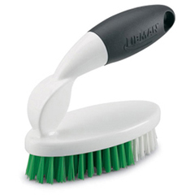
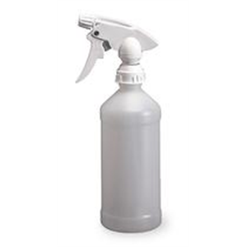
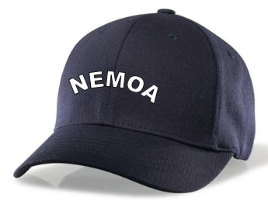
A spray bottle of water
and a small brush
can save you a lot of time and effort.

Slide 8
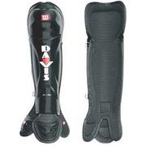
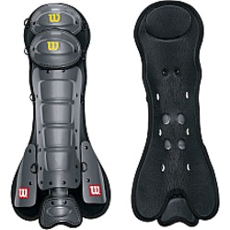
Shin guards
must be worn at all levels.
...obviously should be worn underneath the pants.
Soccer shin guards are not acceptable because they do not cover a big enough area.

Slide 9
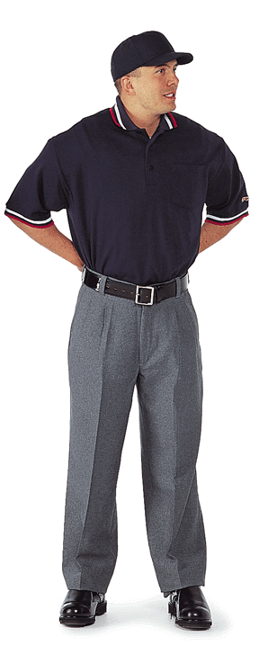
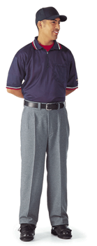
Umpire shirts should be navy blue w/ red and white trim.
The undershirt can be red or navy .

Slide 10
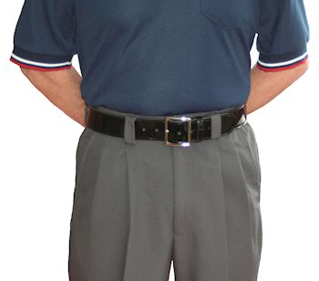
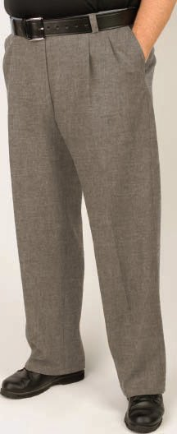
Clean, pressed, charcoal or heather pants that match your partner.

Slide 11
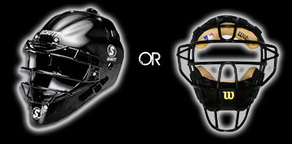
Either the traditional mask
or the hockey style mask
are acceptable.

Slide 12
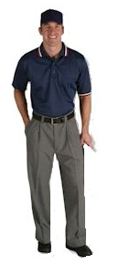
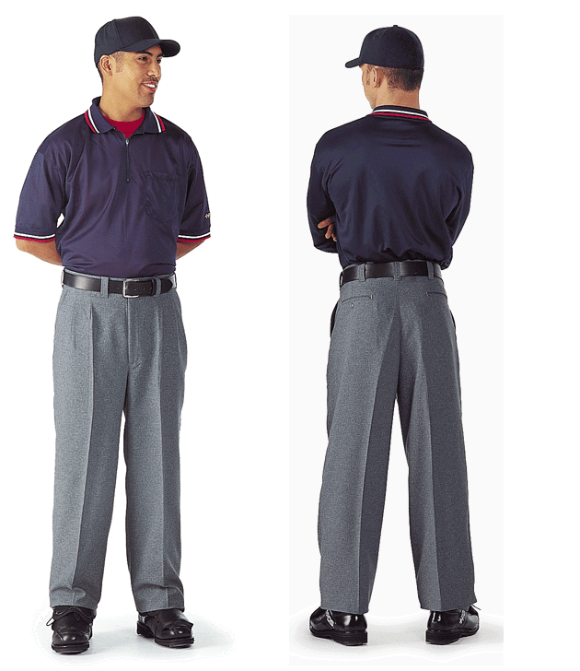
Ratty looking belts are only worn by lousy umpires.

Slide 13
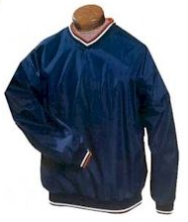
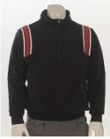
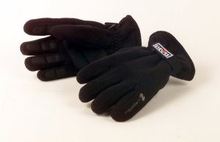
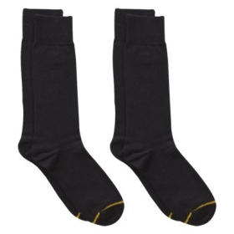
Wind-breakers and inclement weather garments are acceptable. Jackets should be NAVY and may have red & white trim. (Umpire crews do not have to be perfectly matched, but be considerate of common practices when making garment choices.)
Other inclement weather gear should not be distracting,
i.e. black or navy gloves, black or navy ear muffs...
Socks are always blue or black...preferably black.

Slide 14
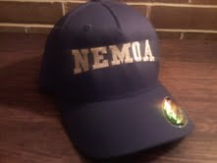
The new NEMOA logo hat was approved by an overwhelming majority prior to the start of the 2012 season. Our original intent was to “phase-in” its use, but as everyone has purchased the new hat and will have them before the start of the 2012 season, it has been decided that that NEMOA hat should immediately be made a part of our uniform dress.

Slide 15
The NEMOA logo hat
is the ONLY logo to be worn by NEMOA umpires
while officiating games contracted by the
NEMOA organization!

Slide 16
Failure to comply
with this directive
could
result in
the forfeiture of future
NEMOA games!

Slide 17
It's about
legal liability
as well as
organizational pride !

Slide 18
Strive to be elite...
NEMOA

Slide 19
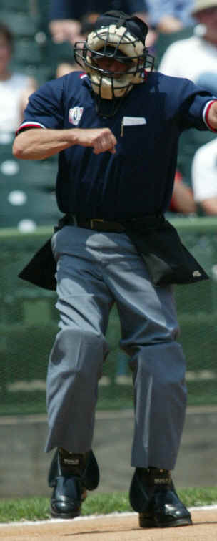
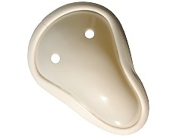
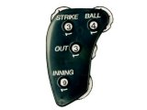
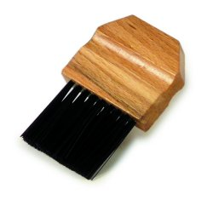
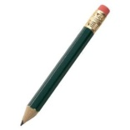
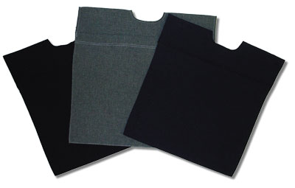
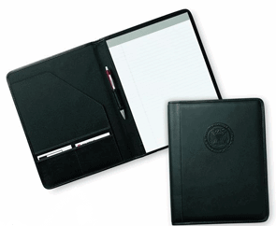
Other important uniform considerations:
Ball Bag(s), one or two-
navy or gray to match pants.
CUP !
or not... ☺
Indicator. Don’t call it a clicker! Always hold it in your left hand.
Plate brush !
Pencil.
(Golf)
Consider a small pad for noting CR, conferences, ejections etc.
The line-up card is not always conducive to good note taking.

Slide 20
Enjoy the Game!
You have
the best seat
in the house!

